Slide 1
Late side-effects of modern breast cancer radiotherapy evidence from past trials and contemporary radiation doses to the lungs and heart
Carolyn Taylor, for the Early Breast Cancer Trialists’ Collaborative Group (EBCTCG)
Intellectual property of the EBCTCG trialists.

Slide 2
Benefits of radiotherapy:
Breast cancer mortality
Absolute benefit in women treated according to current guidelines
a few percent
Intellectual property of the EBCTCG trialists.

Slide 3
Risks of radiotherapy:
Lung cancer and cardiac mortality
Absolute risk in non-smokers
(or ex-smokers)
less than 1%
Intellectual property of the EBCTCG trialists.

Slide 4
Risks of radiotherapy:
Lung cancer and cardiac mortality
Absolute risk in smokers
a few percent
Intellectual property of the EBCTCG trialists.

Slide 5
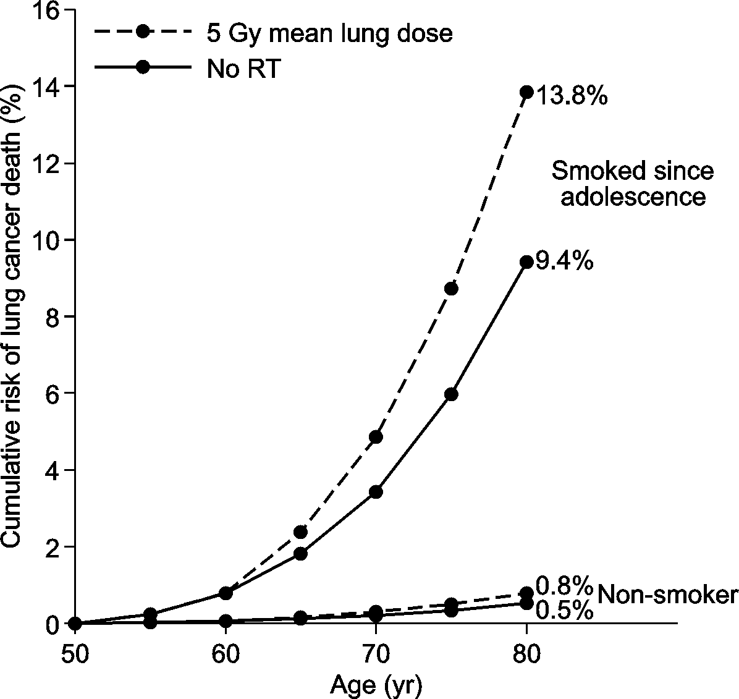
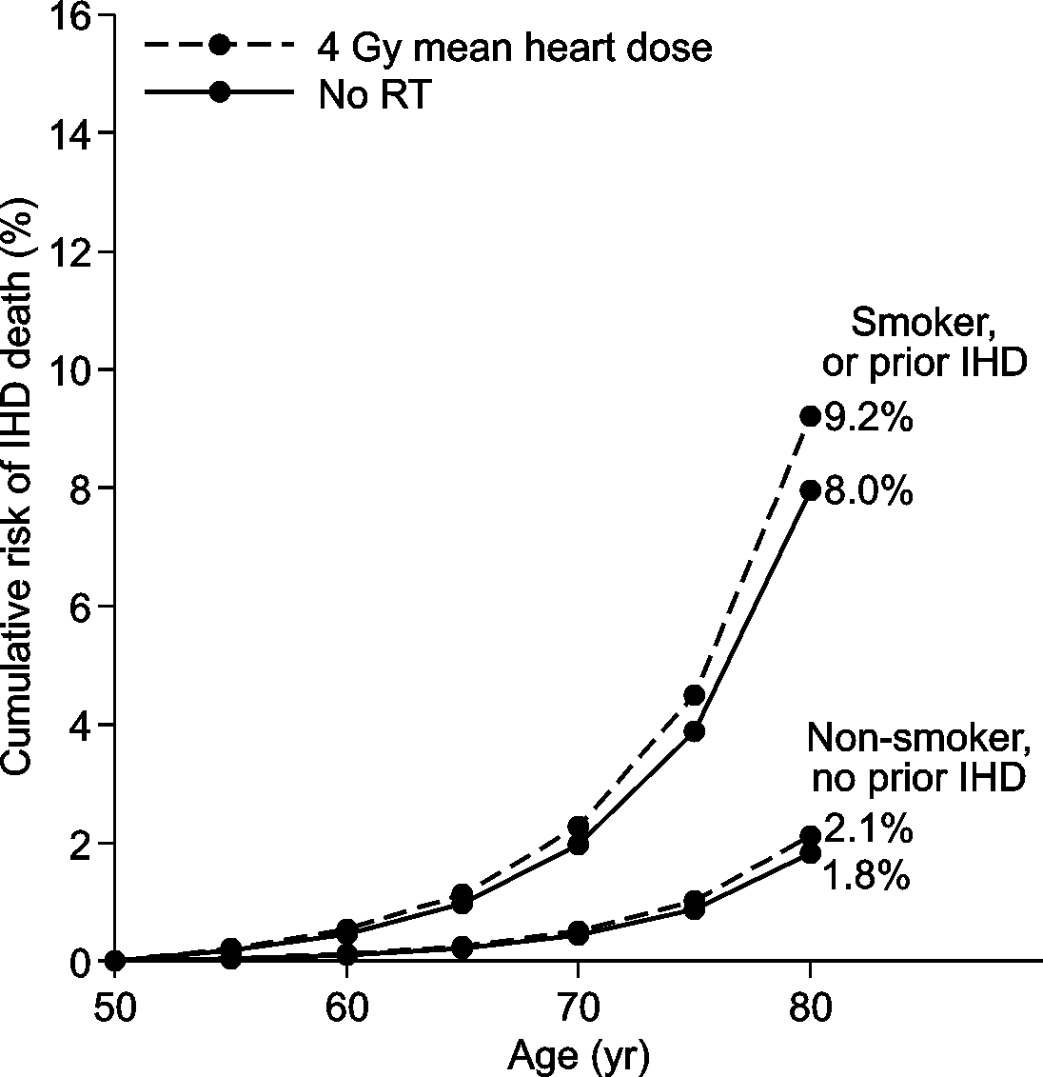
Risks by age 80 of radiotherapy at age 50
Lung cancer
Ischaemic heart disease
Smokers:
A few percent
Non-smokers: <1%
Intellectual property of the EBCTCG trialists.

Slide 6
Randomised to radiotherapy versus not
75 trials, 40,000 women, median entry 1983
Type of surgery | No. of trials | No. of women | Deaths with no recurrence
Mastectomy (for cancer) | 36 | 16,156 | 2921
Breast conserving (for ca.) | 18 | 11,655 | 1270
Various (for cancer) | 17 | 9066 | 1666
Breast conserving (for DCIS) | 4 | 3904 | 207
All trials | 75 | 40,781 | 6064
Intellectual property of the EBCTCG trialists.

Slide 7
Lung and heart doses, past and present
(different, so use trials to obtain excess RR per Gy)
 | Typical dose in RT trials | Typical dose from modern RT*
Two lungs (averaged) | 10 Gy | 5 Gy
Whole heart (averaged) | 6 Gy | 4 Gy
*Literature review, >100 publications in 2010-15
Intellectual property of the EBCTCG trialists.

Slide 8
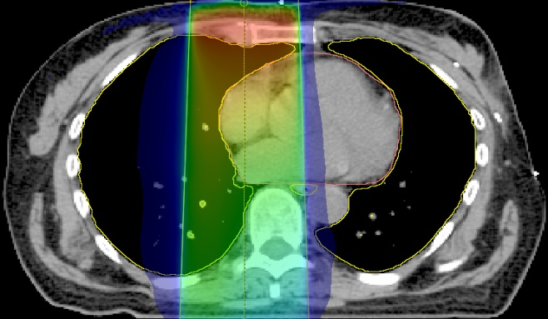
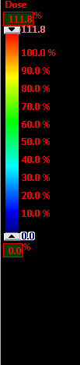
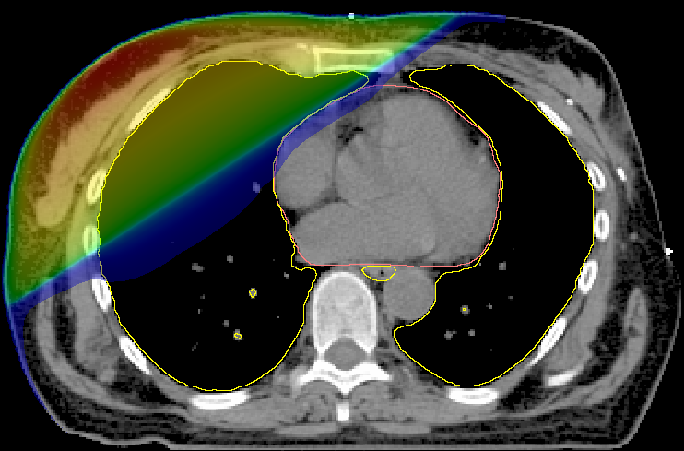
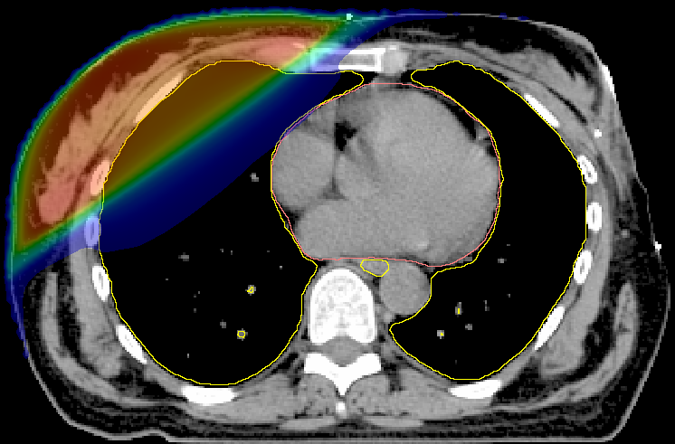
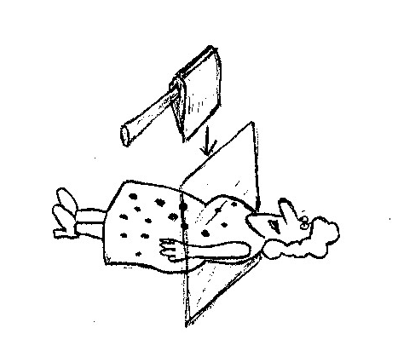
Radiotherapy by decade in trials
1970s
1980s
1990s
Intellectual property of the EBCTCG trialists.

Slide 9
Lung and heart doses, past and present
(different, so use trials to obtain excess RR per Gy)
 | Typical dose in RT trials | Typical dose from modern RT*
Two lungs (averaged) | 10 Gy | 5 Gy
Whole heart (averaged) | 6 Gy | 4 Gy
*Literature review, >100 publications in 2010-15
Intellectual property of the EBCTCG trialists.

Slide 10
Rate ratio (RR) from trials, and RR per Gy
RR (95% CI) in trials
Lung cancer (10+ years) 2.10 (1.48-2.98)
Cardiac mortality 1.30 (1.15-1.46)
Average doses in the trials
Lung 10 Gray
Heart 6 Gray
Excess RR per Gray in trials
Lung cancer 12% per Gray
Cardiac mortality 4% per Gray
Intellectual property of the EBCTCG trialists.
Notes:
TheseNon smoers (or exsmokershave klower lung cancer risk and low heart diseasde rates
The excess rate ratio is the expected ratio of events in
2 type sizes for headings, something like 36 and 32 throughout. Every word I need to use. Keep slides simple.

Slide 11
Rate ratio (RR) from trials, and RR per Gy
RR (95% CI) in trials
Lung cancer (10+ years) 2.10 (1.48-2.98)
Cardiac mortality 1.30 (1.15-1.46)
Average doses in the trials
Lung 10 Gy
Heart 6 Gy
Excess RR per Gray in trials
Lung cancer 12% per Gray
Cardiac mortality 4% per Gray
Intellectual property of the EBCTCG trialists.

Slide 12
Rate ratio (RR) from trials, and RR per Gy
RR (95% CI) in trials
Lung cancer (10+ years) 2.10 (1.48-2.98)
Cardiac mortality 1.30 (1.15-1.46)
Average doses in the trials
Lung 10 Gy
Heart 6 Gy
Excess RR per Gy in trials
Lung cancer 11% per Gy
Cardiac mortality 4% per Gy
Intellectual property of the EBCTCG trialists.

Slide 13
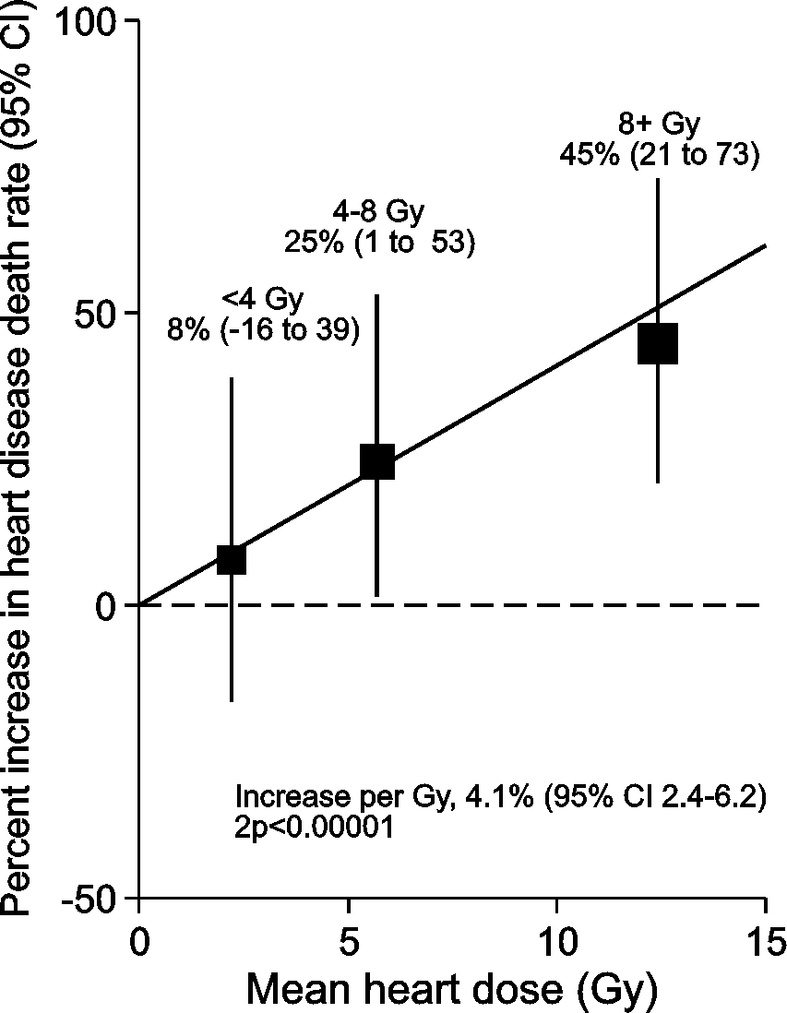
Heart dose-response relationship
1253 cardiac deaths
4 Gy
Percent increase per Gy: 4.1% (2.4 - 6.2)
2p<0.00001
Intellectual property of the EBCTCG trialists.

Slide 14
Rate ratio (RR) from trials, and RR per Gy
RR (95% CI) in trials
Lung cancer (10+ years) 2.10 (1.48-2.98)
Cardiac mortality 1.30 (1.15-1.46)
Average doses in the trials
Lung 10 Gy
Heart 6 Gy
Excess RR per Gy in trials
Lung cancer 11% per Gy
Cardiac mortality 4% per Gy
Intellectual property of the EBCTCG trialists.

Slide 15
Risks by age 80 of radiotherapy at age 50
Lung cancer
Ischaemic heart disease
Smokers:
A few percent
Non-smokers: <1%
Intellectual property of the EBCTCG trialists.

Slide 16
Conclusions
Smoking status can determine the net long-term effect of breast cancer radiotherapy on mortality.
Smoking cessation at the time of radiotherapy may avoid most of the risk.
Intellectual property of the EBCTCG trialists.

Slide 17
The end
Intellectual property of the EBCTCG trialists.

