Slide 1
20-Year Risks of Breast-Cancer Recurrence
after Stopping Endocrine Therapy at 5 Years
The Early Breast Cancer Trialists’ Collaborative Group (EBCTCG)
N Engl J Med 2017; 377:1836-46

Slide 2
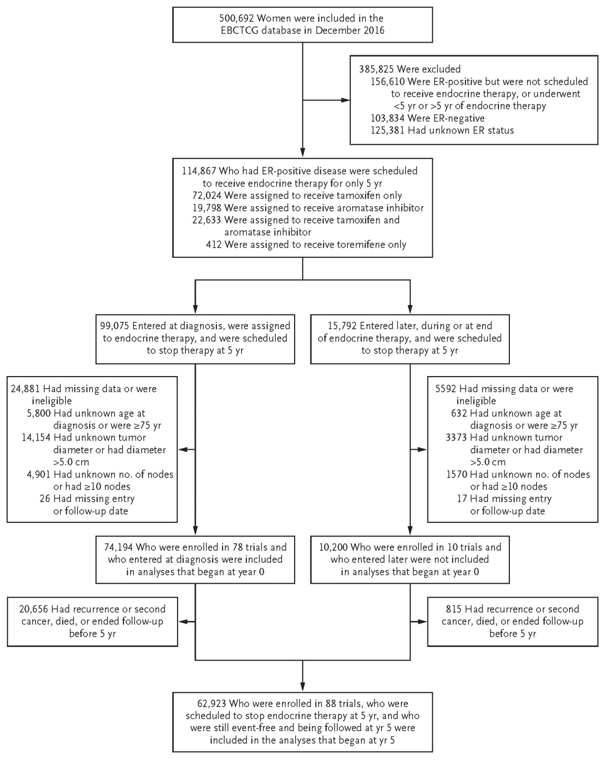
Selection of Women with Breast Cancer
from 88 Trials of Adjuvant Breast-Cancer Therapy
ER+, 5 years
endocrine
therapy (ET)
completed:
n=63,000

Slide 3
Nodal Status and Distant Recurrence, Years 0 to 20
52 N4-9
50
45
40
36
30
31 N1-3
Distant recurrence, %
25
22
20
19
22 N0
10
16
10
11
6
0
ET for 5 years
years
0
5
10
15
20
No. at risk (and, in each 5-year period, no. of events and annual rate)
N4-9
12333
(2568, 4.8%)
8116
(969, 4.0%)
2165
(121, 3.1%)
259
(13, 2.2%)
52
N1-3
31936
(3126, 2.2%)
23576
(1421, 1.9%)
7250
(241, 1.7%)
949
(39, 1.8%)
183
N0
29925
(1646, 1.2%)
24081
(835, 1.1%)
8571
(272, 1.3%)
1982
(68, 1.4%)
414

Slide 4
Nodal Status and Breast Cancer Death, Years 0 to 20
50
49 N4-9
40
40
30
29
Breast cancer mortality, %
28 N1-3
21
20
12
14
15 N0
10
5
12
8
0
3
ET for 5 years
years
0
5
10
15
20
No. at risk (and, in each 5-year period, no. of events and annual rate)
N4-9
12333
(1463, 2.6%)
9079
(1154, 4.1%)
2481
(185, 3.7%)
294
(20, 2.3%)
57
N1-3
31936
(1600, 1.1%)
24866
(1506, 1.9%)
7728
(319, 1.9%)
1011
(52, 1.8%)
197
N0
29925
(826, 0.6%)
24819
(890, 1.0%)
8926
(228, 0.8%)
2144
(77, 1.0%)
476

Slide 5
Nodal Status and Distant Recurrence, Years 5 to 20
T1 disease
45
34 T1N4-9
30
25
Distant recurrence, %
20 T1N1-3
15
15
14
13 T1N0
7
8
ET for 5 years
0
4
0
5
10
15
20
years
No. at risk (and, in each 5-year period, no. of events and annual rate)
T1N4-9
3832
(391, 3.2%)
1193
(68, 2.6%)
214
(11, 2.2%)
32
T1N1-3
14342
(734, 1.5%)
5138
(162, 1.5%)
817
(35, 1.7%)
154
T1N0
19402
(509, 0.8%)
8020
(218, 1.0%)
2345
(58, 1.0%)
440

Slide 6
Nodal Status and Distant Recurrence, Years 5 to 20
T2 disease
45
41 T2N4-9
31
30
26 T2N1-3
Distant recurrence, %
20
19
19 T2N0
15
11
14
ET for 5 years
7
0
0
5
10
15
20
years
No. at risk (and, in each 5-year period, no. of events and annual rate)
T2N4-9
4952
(688, 4.5%)
1517
(106, 3.3%)
285
(12, 1.7%)
51
T2N1-3
10950
(842, 2.4%)
3551
(134, 1.8%)
614
(28, 1.9%)
114
T2N0
9445
(512, 1.6%)
3901
(152, 1.4%)
1129
(37, 1.3%)
218

Slide 7
Tumor Diameter and Distant Recurrence, Years 5 to 20
30
Rate ratio (T1a/bN0 vs. T1cN0), 0.67 (95% CI, 0.56–0.80)
P<0.001
20
Distant recurrence, %
14 T1cN0
10
9
10 T1a/bN0
10% risk,
yrs. 5-20
4
7
ET for 5 years
0
3
0
5
10
15
20
years
No. at risk (and, in each 5-year period, no. of events and annual rate)
T1cN0
13875
(413, 0.8%)
5967
(171, 1.1%)
1641
(46, 1.2%)
309
T1a/bN0
5527
(96, 0.5%)
2053
(47, 0.8%)
704
(12, 0.7%)
131

Slide 8
Tumor Diameter and Any Breast-Cancer Event, Years 5 to 20
30
Rate ratio (T1a/bN0 vs. T1cN0), 0.85 (95% CI, 0.75–0.96)
P=0.01
21 T1cN0
20
19 T1a/bN0
Any breast cancer event, %
14
10
13
7
6
ET for 5 years
0
0
5
10
15
20
years
No. at risk (and, in each 5-year period, no. of events and annual rate)
T1cN0
13875
(700, 1.4%)
5832
(264, 1.7%)
1569
(62, 1.7%)
294
T1a/bN0
5527
(210, 1.2%)
2002
(86, 1.5%)
659
(22, 1.4%)
119

Slide 9
Tumor Grade and Distant Recurrence, Years 5 to 20
30
Rate ratio (low vs. high grade), 0.50 (95% CI, 0.37–0.67)
P<0.001
20
17 High
Distant recurrence, %
11
13 Mod.
10
10 Low grade
8
5
10% risk,
yrs. 5-20
6
ET for 5 years
4
0
2
0
5
10
15
20
years
No. at risk (and, in each 5-year period, no. of events and annual rate)
High
3054
(92, 0.9%)
1010
(32, 1.3%)
188
(6, 2.6%)
2
Mod.
7363
(186, 0.7%)
2761
(60, 1.0%)
474
(6, 1.1%)
6
Low grade
3524
(49, 0.4%)
1258
(23, 0.8%)
239
(2, 0.6%)
6

Slide 10
Tumor Grade and Any Breast-Cancer Event, Years 5 to 20
30
Rate ratio (low vs. high grade), 0.67 (95% CI, 0.54–0.82)
P<0.001
26 High
22 Mod.
20
17
17 Low grade
Any breast cancer event, %
15
10
8
12
6
ET for 5 years
5
0
0
5
10
15
20
years
No. at risk (and, in each 5-year period, no. of events and annual rate)
High
3054
(158, 1.6%)
987
(49, 2.1%)
174
(6, 3.0%)
0
Mod.
7363
(337, 1.3%)
2693
(108, 1.8%)
449
(11, 2.1%)
6
Low grade
3524
(136, 1.1%)
1224
(36, 1.4%)
227
(4, 1.4%)
6

Slide 11
Associations of various factors with rate ratio of distant recurrence (RR)
during the 5 years of endocrine therapy and after it
Years 0-5 (on endocrine, 74,194 women)
Years 5-20 (off endocrine, 62,923 women)
Events
Women
RR (95% CI)
Events
Women
RR (95% CI)
Tumor diameter and
no. of nodes (TN status)
T1N0 (1-20 mm)
0.44 (0.41-0.48)
0.56 (0.51-0.61)
744
19682
785
19402
T2N0 (21-50 mm)
1.00 (0.92-1.09)
1.00 (0.91-1.10)
902
10243
701
9445
T1N1-3
1203
17171
0.89 (0.84-0.94)
931
14342
1.26 (1.18-1.34)
T2N1-3
1923
14765
1.74 (1.66-1.82)
1004
10950
1.85 (1.74-1.97)
T1N4-9
818
5033
2.20 (2.05-2.36)
470
3832
2.45 (2.23-2.69)
T2N4-9
1750
7300
3.46 (3.28-3.64)
806
4952
3.32 (3.09-3.57)
Analyses given TN status:
Age at diagnosis (years)
After
5-yr ET,
only TN
status
matters
much
<35
338
1585
2.18 (1.96-2.43)
114
1009
1.51 (1.26-1.83)
35-44
1288
10344
1.22 (1.15-1.29)
623
7859
1.00 (0.92-1.09)
45-54
2017
22568
0.88 (0.84-0.92)
1267
19326
0.86 (0.81-0.91)
55-64
2430
25439
0.97 (0.93-1.02)
1736
22337
1.04 (0.99-1.09)
65-74
1267
14258
0.95 (0.89-1.01)
957
12392
1.12 (1.04-1.20)
Tumor grade (differentiation)
Low (well diff.)
337
8913
0.45 (0.41-0.50)
352
8023
0.72 (0.65-0.80)
Moderate
2434
29158
0.86 (0.83-0.90)
1575
23490
1.03 (0.98-1.08)
High
2617
17137
1.52 (1.46-1.58)
863
12077
1.12 (1.05-1.20)
Unknown grade
1952
18986
1907
19333
Ki-67 status
0-9%
143
3166
0.60 (0.50-0.71)
129
2796
0.86 (0.72-1.03)
10-19%
236
3379
0.90 (0.79-1.02)
167
2824
0.96 (0.82-1.12)
?20%
391
2919
1.56 (1.40-1.74)
168
2072
1.24 (1.05-1.46)
Unknown
6570
64730
4233
55231
Progesterone receptor status
ER+, PgR–poor
1.42 (1.35-1.49)
1.07 (0.99-1.15)
1600
11733
677
8875
ER+, PgR+
4923
56608
0.91 (0.89-0.94)
2973
45240
0.99 (0.95-1.03)
PgR unknown
817
5853
1047
8808
HER2 over-expression
(trials without trastuzumab)
HER2-negative
1195
17448
0.90 (0.84-0.95)
734
13262
1.02 (0.94-1.10)
HER2-positive
392
3200
1.57 (1.42-1.73)
102
2156
0.87 (0.71-1.06)
HER2 unknown
4205
39167
3352
38215
0.5
1
2
4
0.5
1
2
4

Slide 12
After 5 years of endocrine therapy:
Recurrences continue steadily, years 5-20
Even low-grade T1N0 disease has 10% risk of distant recurrence in years 5-20
Risk increases with grade and TN status

