Slide 1

Aromatase inhibitors versus tamoxifen in early breast cancer: patient-level meta-analysis of the randomised trials.
Early Breast Cancer Trialists’ Collaborative Group (EBCTCG)
www.thelancet.com
Published online July 24, 2015
http://dx.doi.org/10.1016/S0140-6736(15)61074-1

Slide 2
EBCTCG’s Aromatase Inhibitor Overview
ASCO guidelines on adjuvant endocrine treatment: postmenopausal women “should consider incorporating AI therapy at some point …The optimal timing and duration remain unresolved.” (Burstein, JCO May 27, 2014)
EBCTCG meta-analysis: three main comparisons:
[A] Continuous AI (5yrs) vs Tam (5yrs)
[B] Continuous AI (5yrs) vs Tam (2-3yrs) then AI (to 5yrs)
[C] Tam (2-3yrs) then AI (to 5yrs) vs Tam (5yrs)

Slide 3
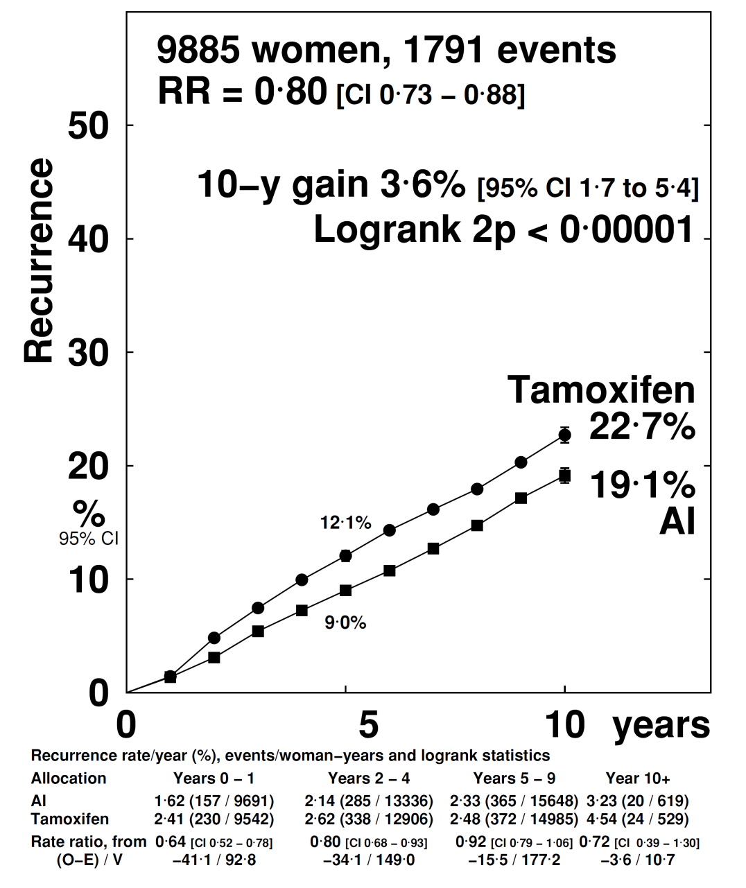
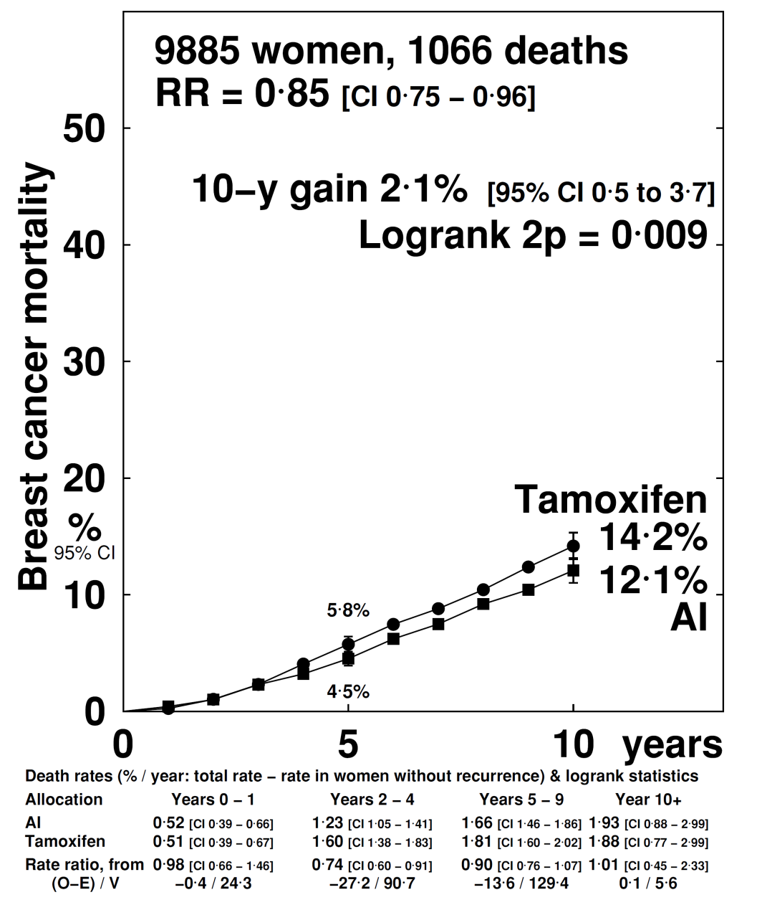
[A] AI (5 years) vs Tamoxifen (5 years)
Recurrence
Breast cancer mortality

Slide 4
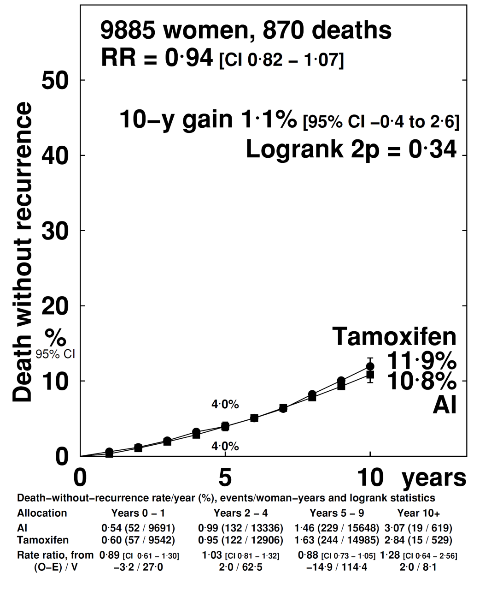
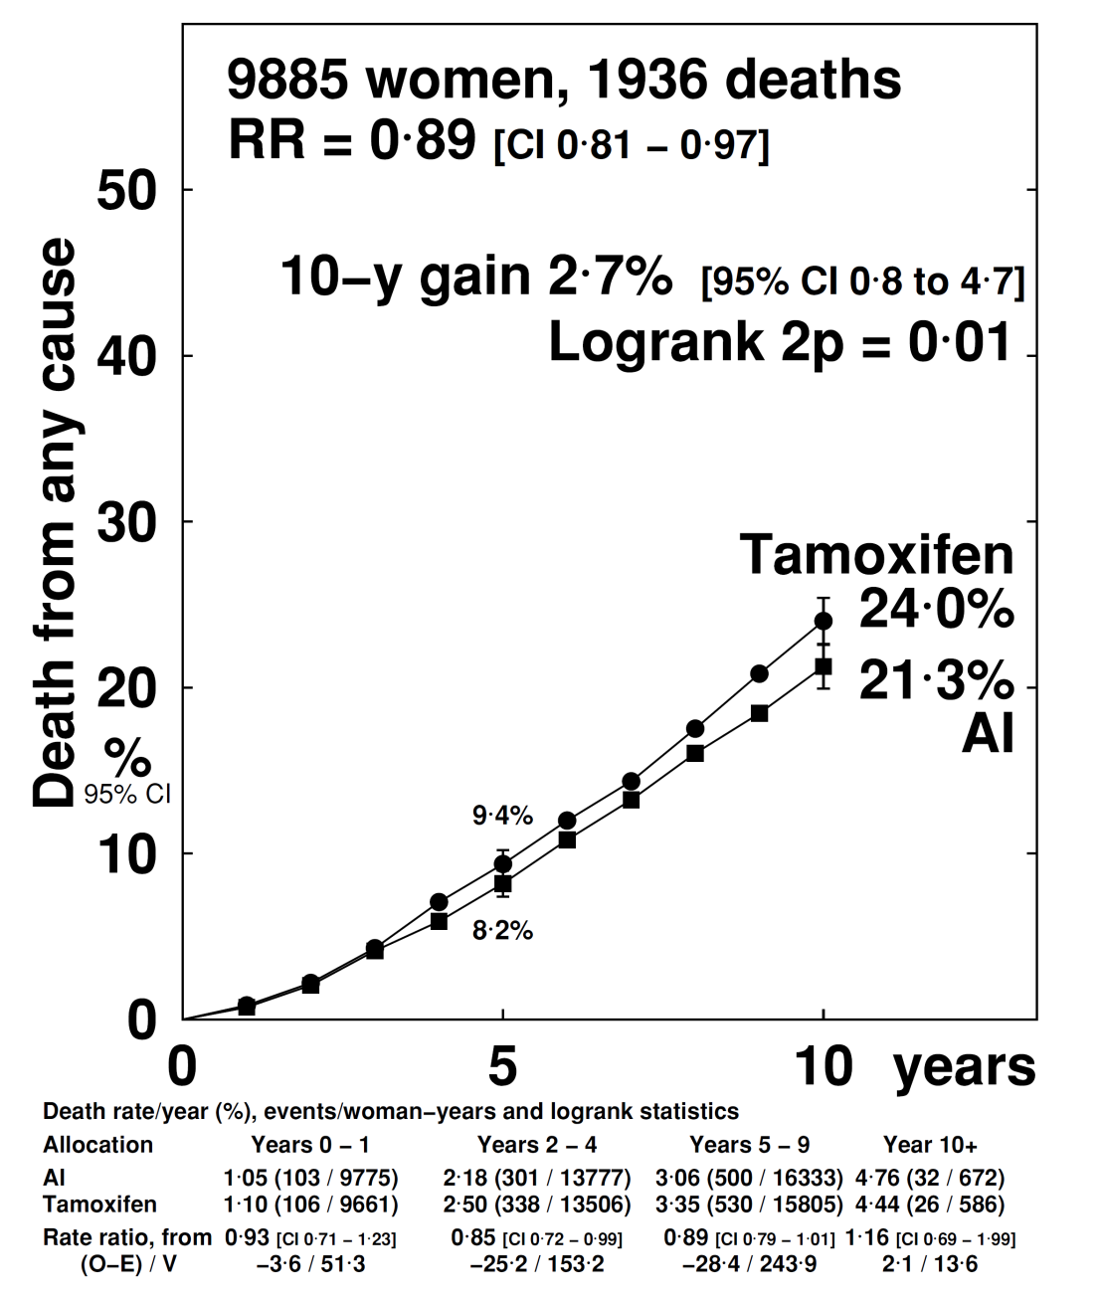
[A] AI (5 years) vs Tamoxifen (5 years)
Non-BC mortality
All-cause mortality

Slide 5
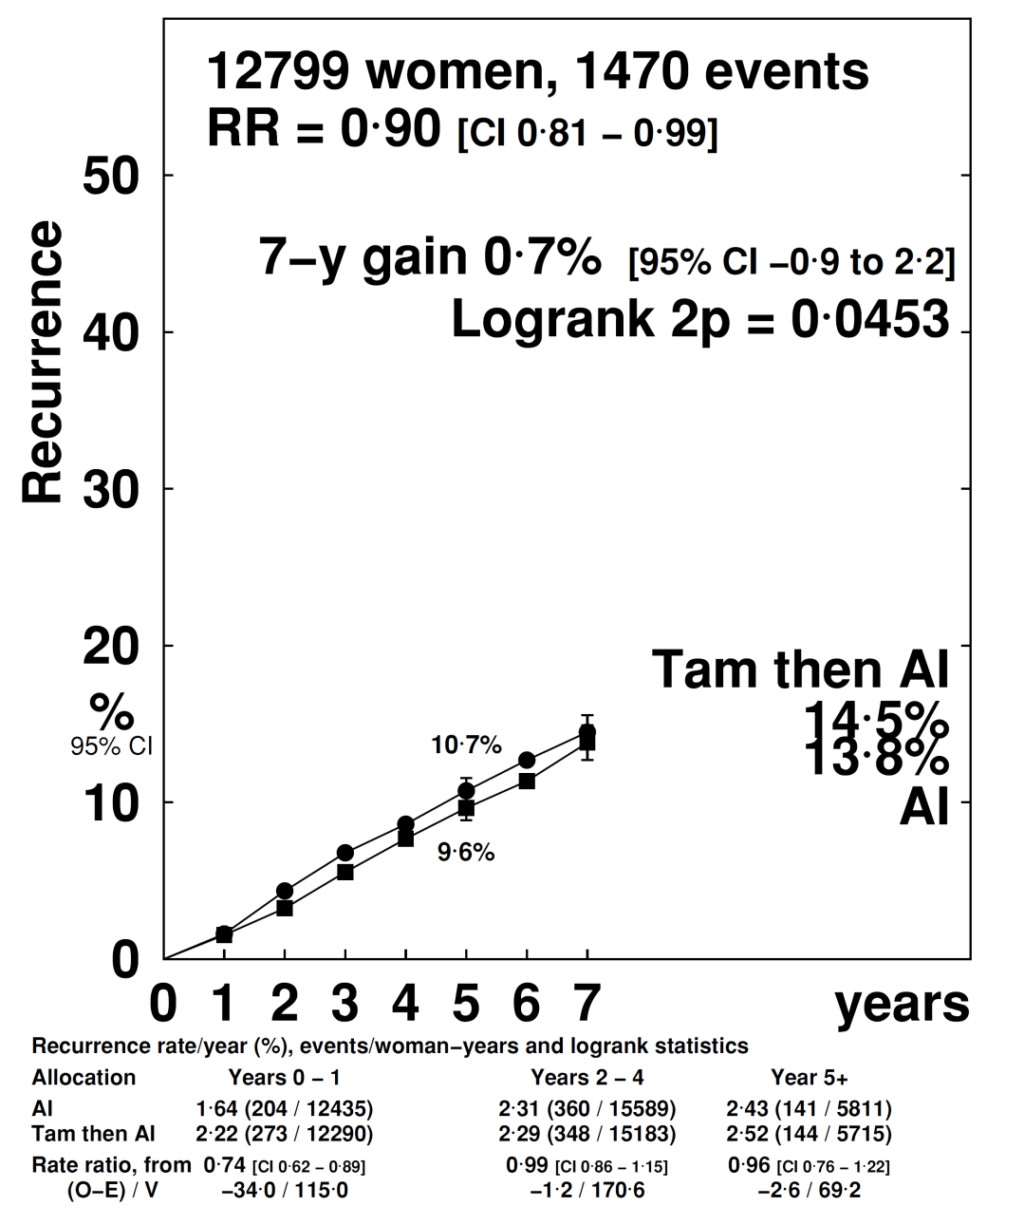
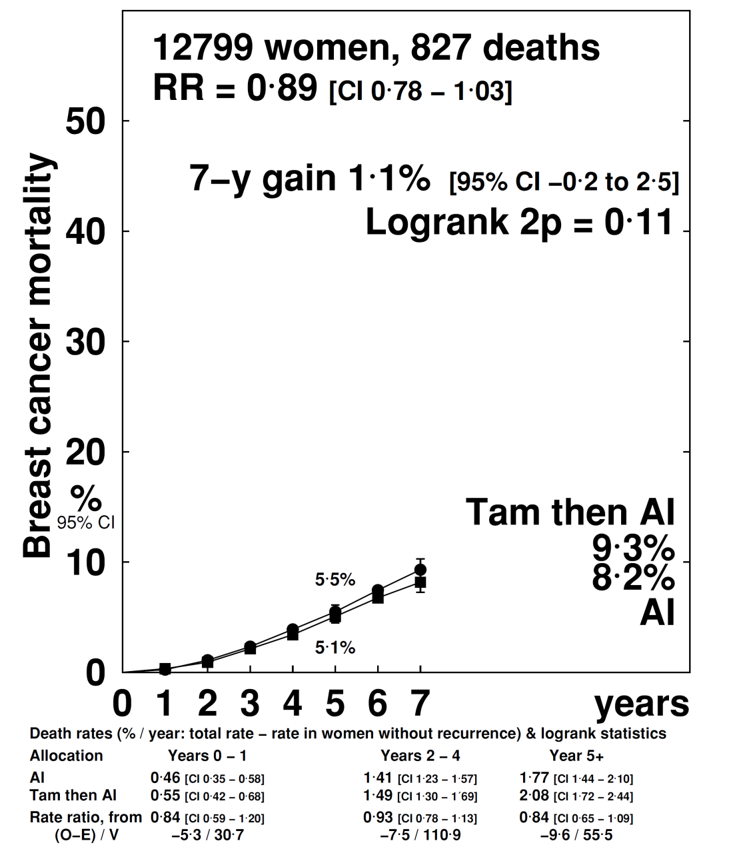
[B] AI (5 yrs) vs Tam to yr 2-3 then AI to yr 5
Recurrence
Breast cancer mortality

Slide 6
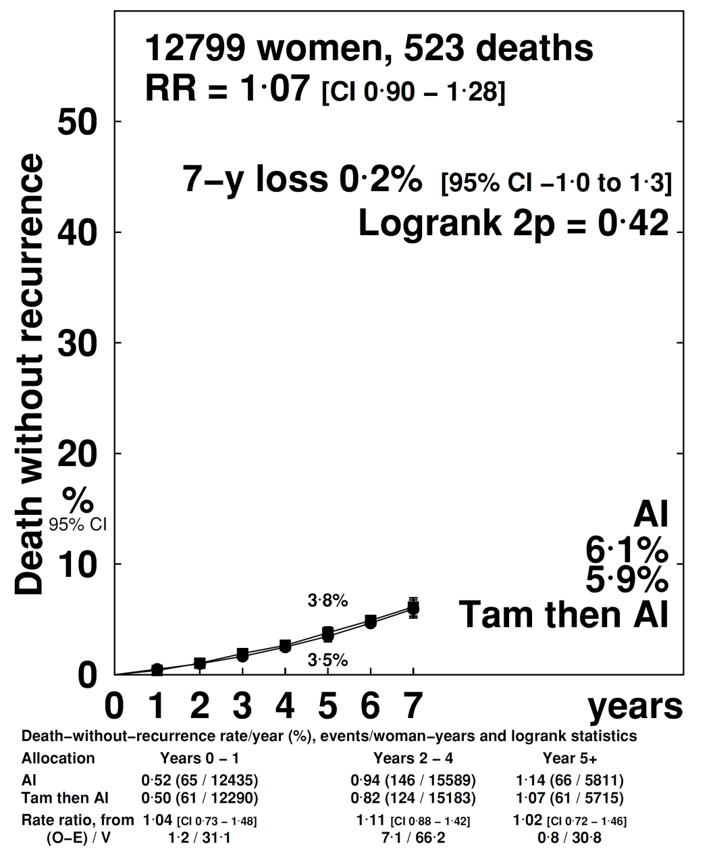
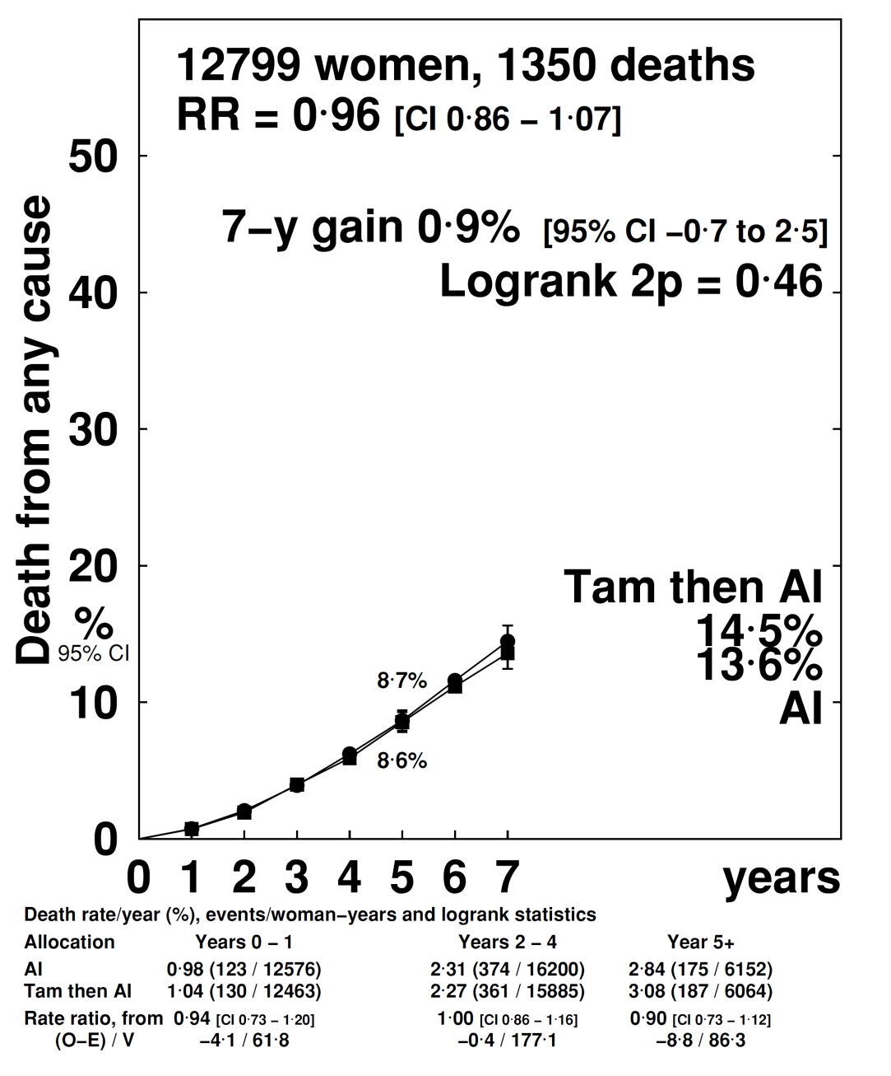
[B] AI (5 yrs) vs Tam to yr 2-3 then AI to yr 5
Non-BC mortality
All-cause mortality

Slide 7
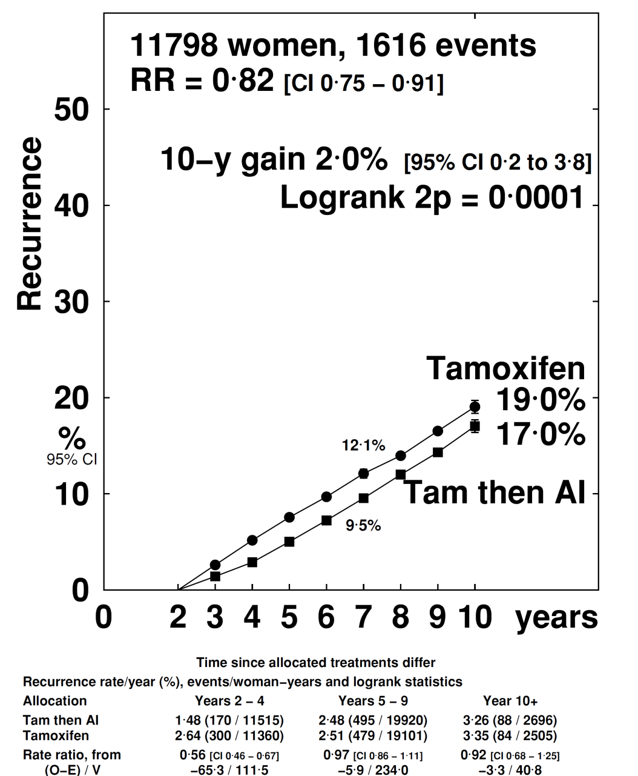
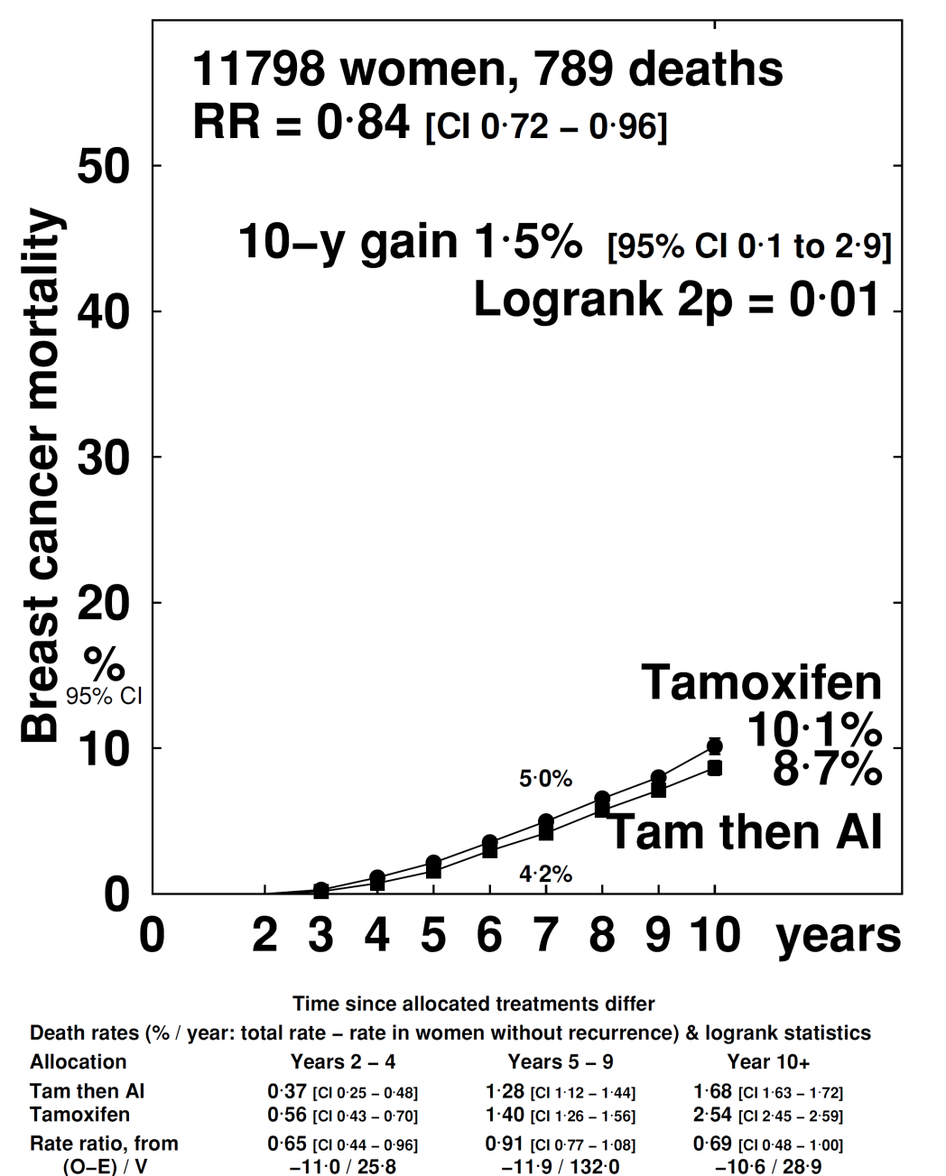
[C] Tam to yr 2-3 then AI to yr 5 vs Tam (5 yrs)
Recurrence
Breast cancer mortality

Slide 8

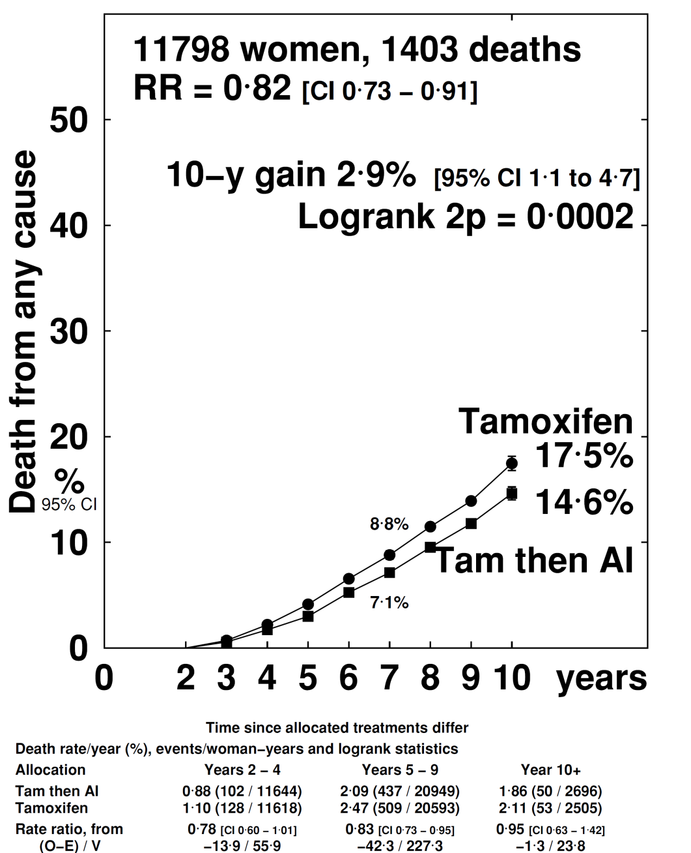
[C] Tam to yr 2-3 then AI to yr 5 vs Tam (5 yrs)
Non-BC mortality
All-cause mortality

Slide 9
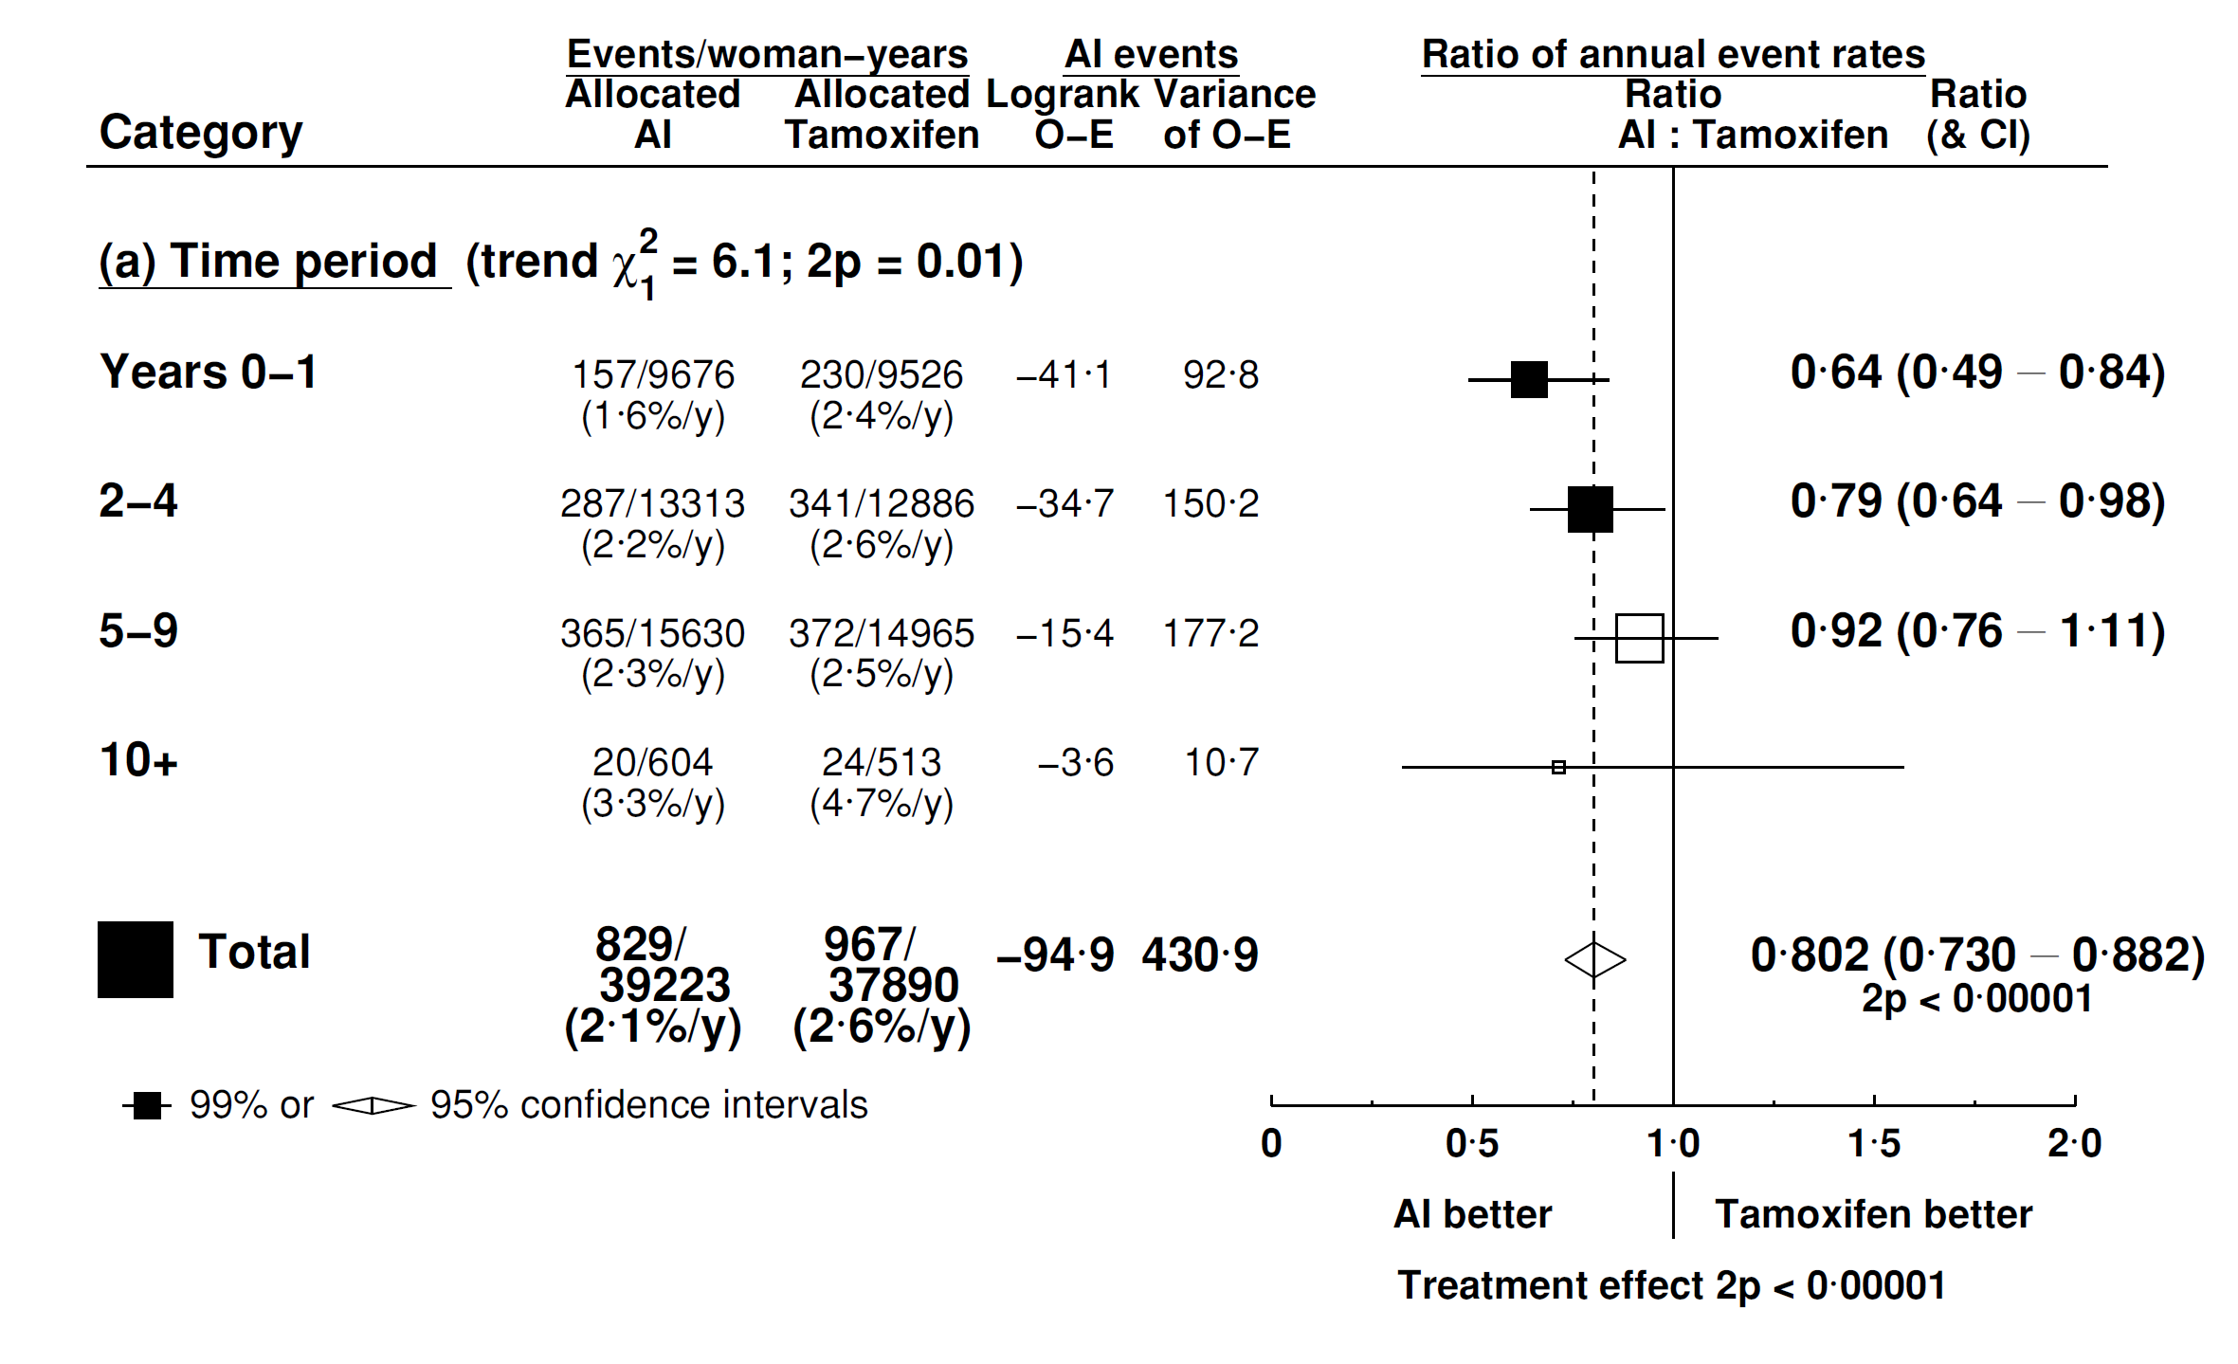
[A] AI (5 years) vs Tamoxifen (5 years)
Recurrence by follow-up period

Slide 10
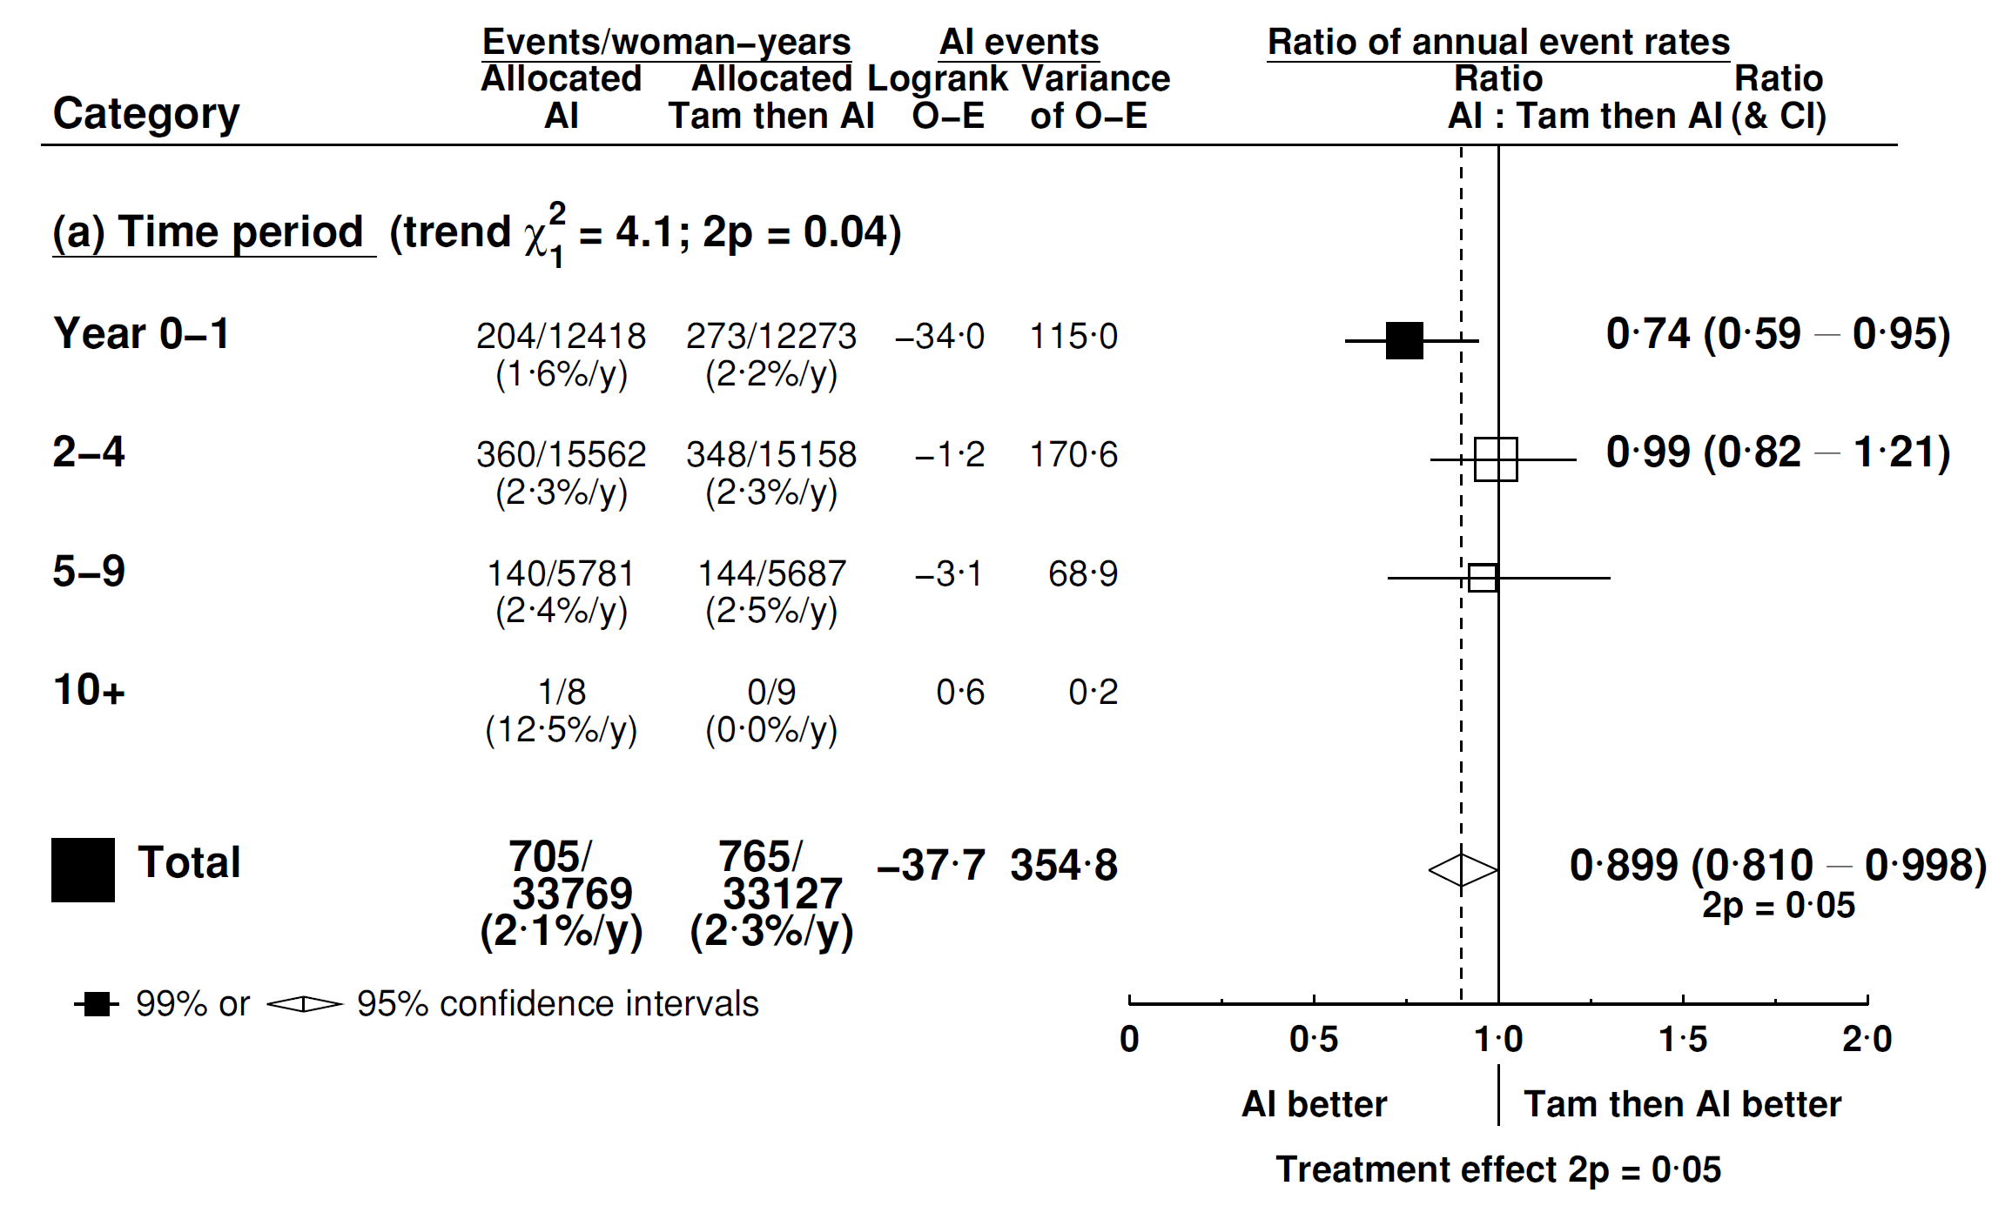
[B] AI (5 yrs) vs Tam to yr 2-3 then AI to yr 5
Recurrence by follow-up period

Slide 11
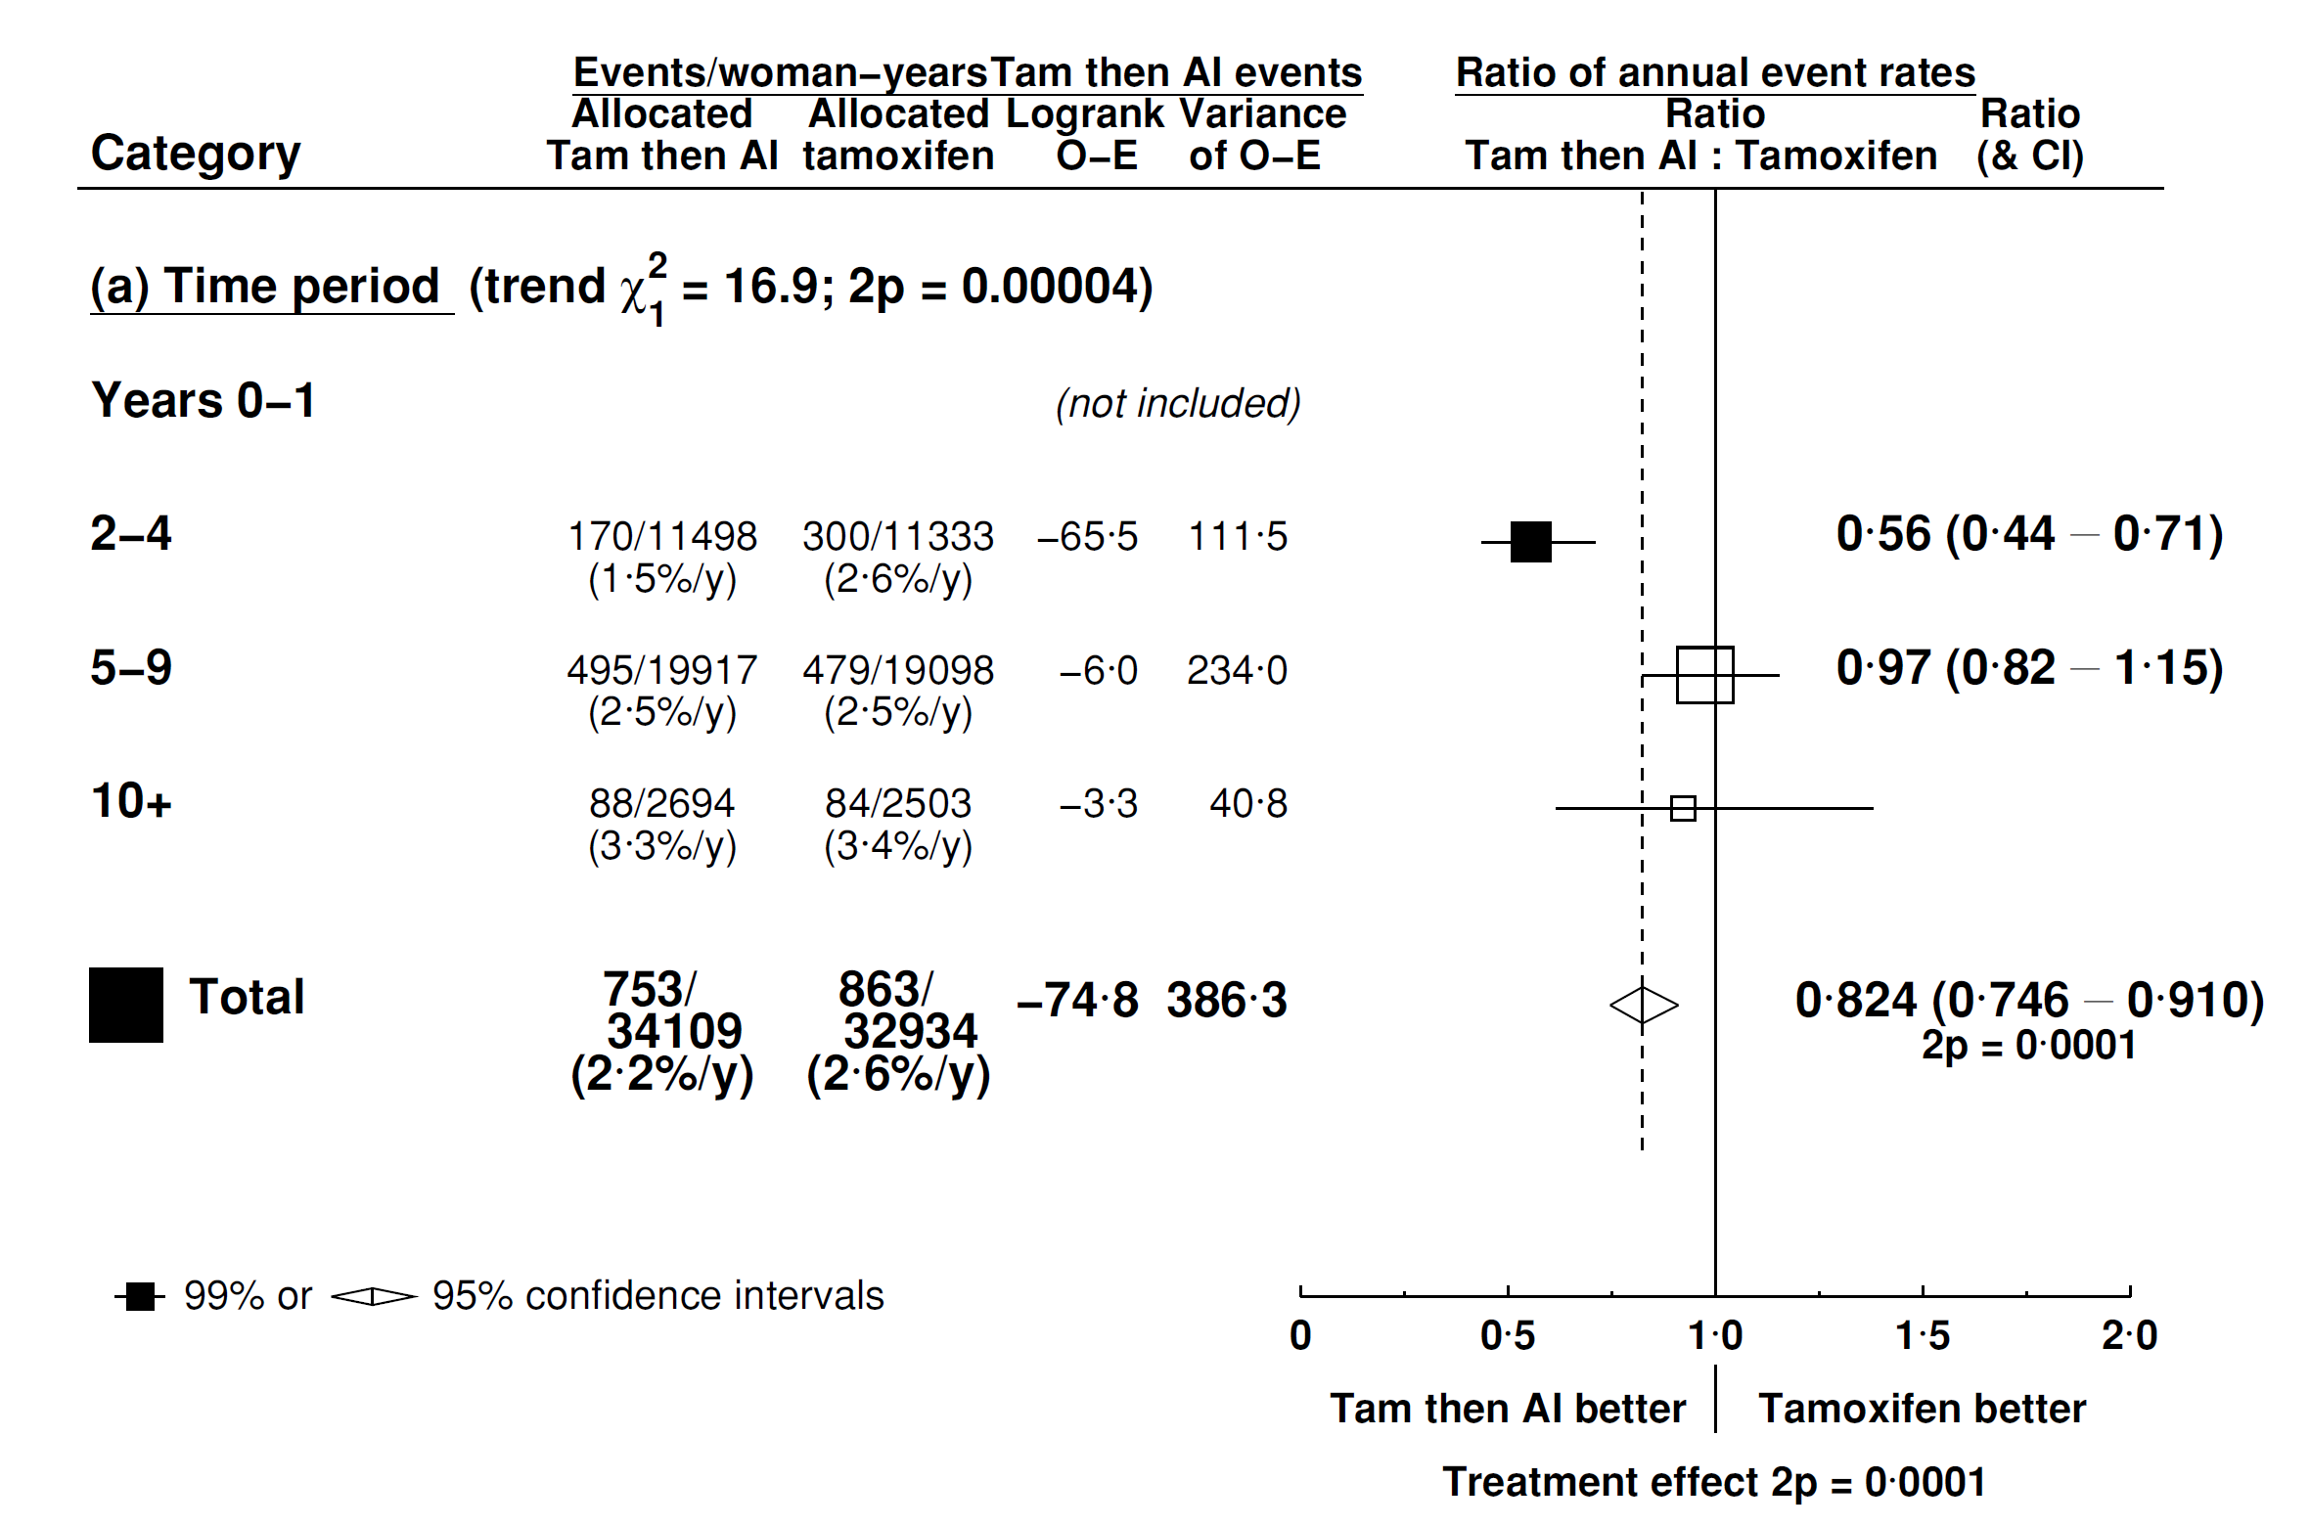
[C] Tam to yr 2-3 then AI to yr 5 vs Tam (5 yrs)
Recurrence by follow-up period

Slide 12
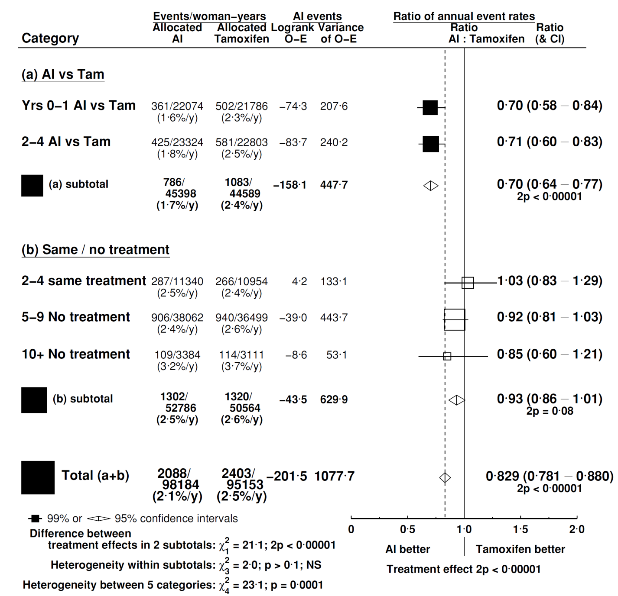
AI vs Tamoxifen recurrence (all trials)

Slide 13
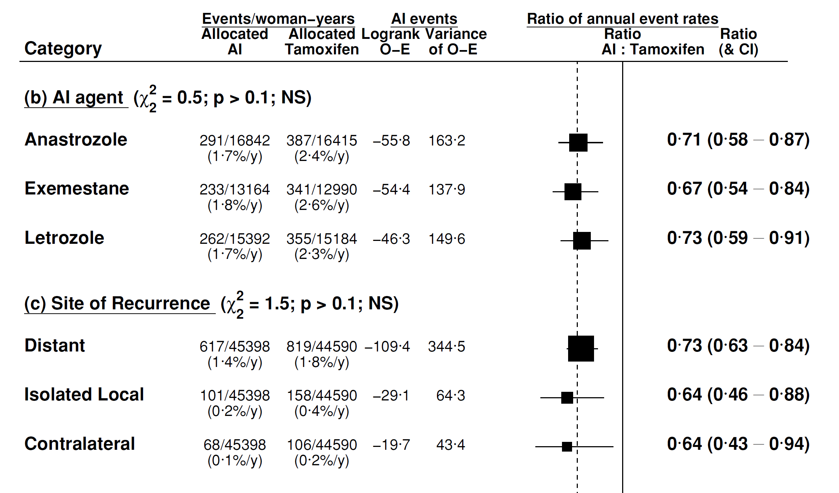
AIs: recurrence by agent and site

Slide 14
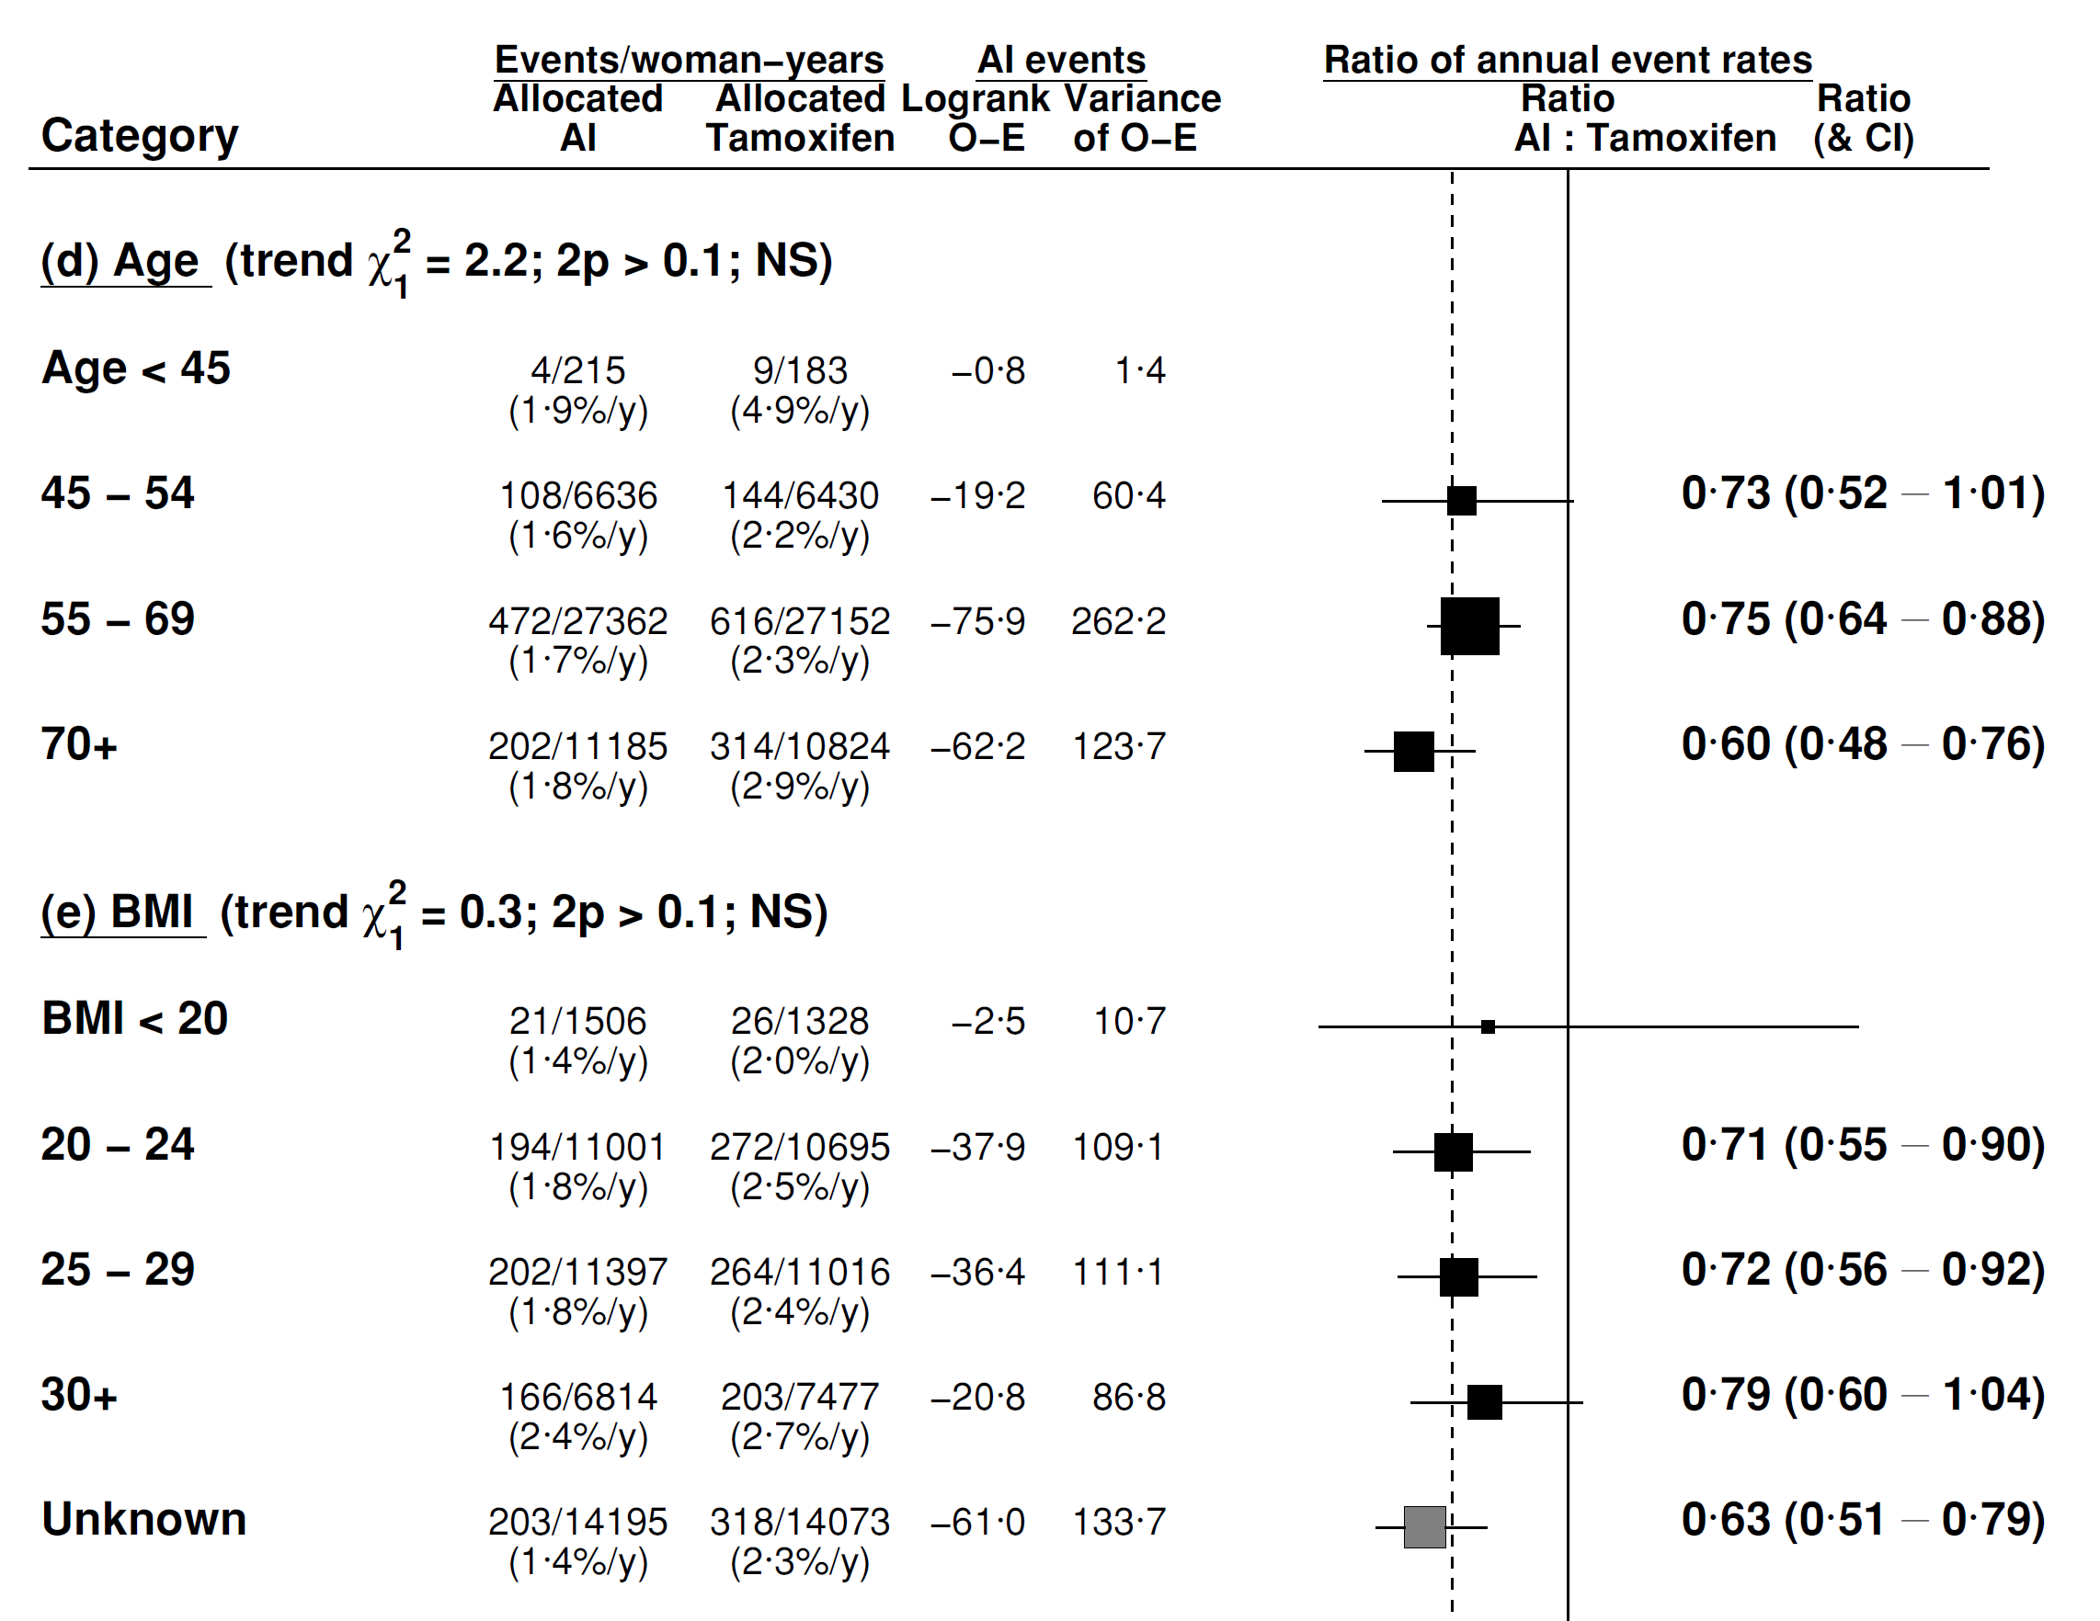
AIs: recurrence by age and BMI

Slide 15
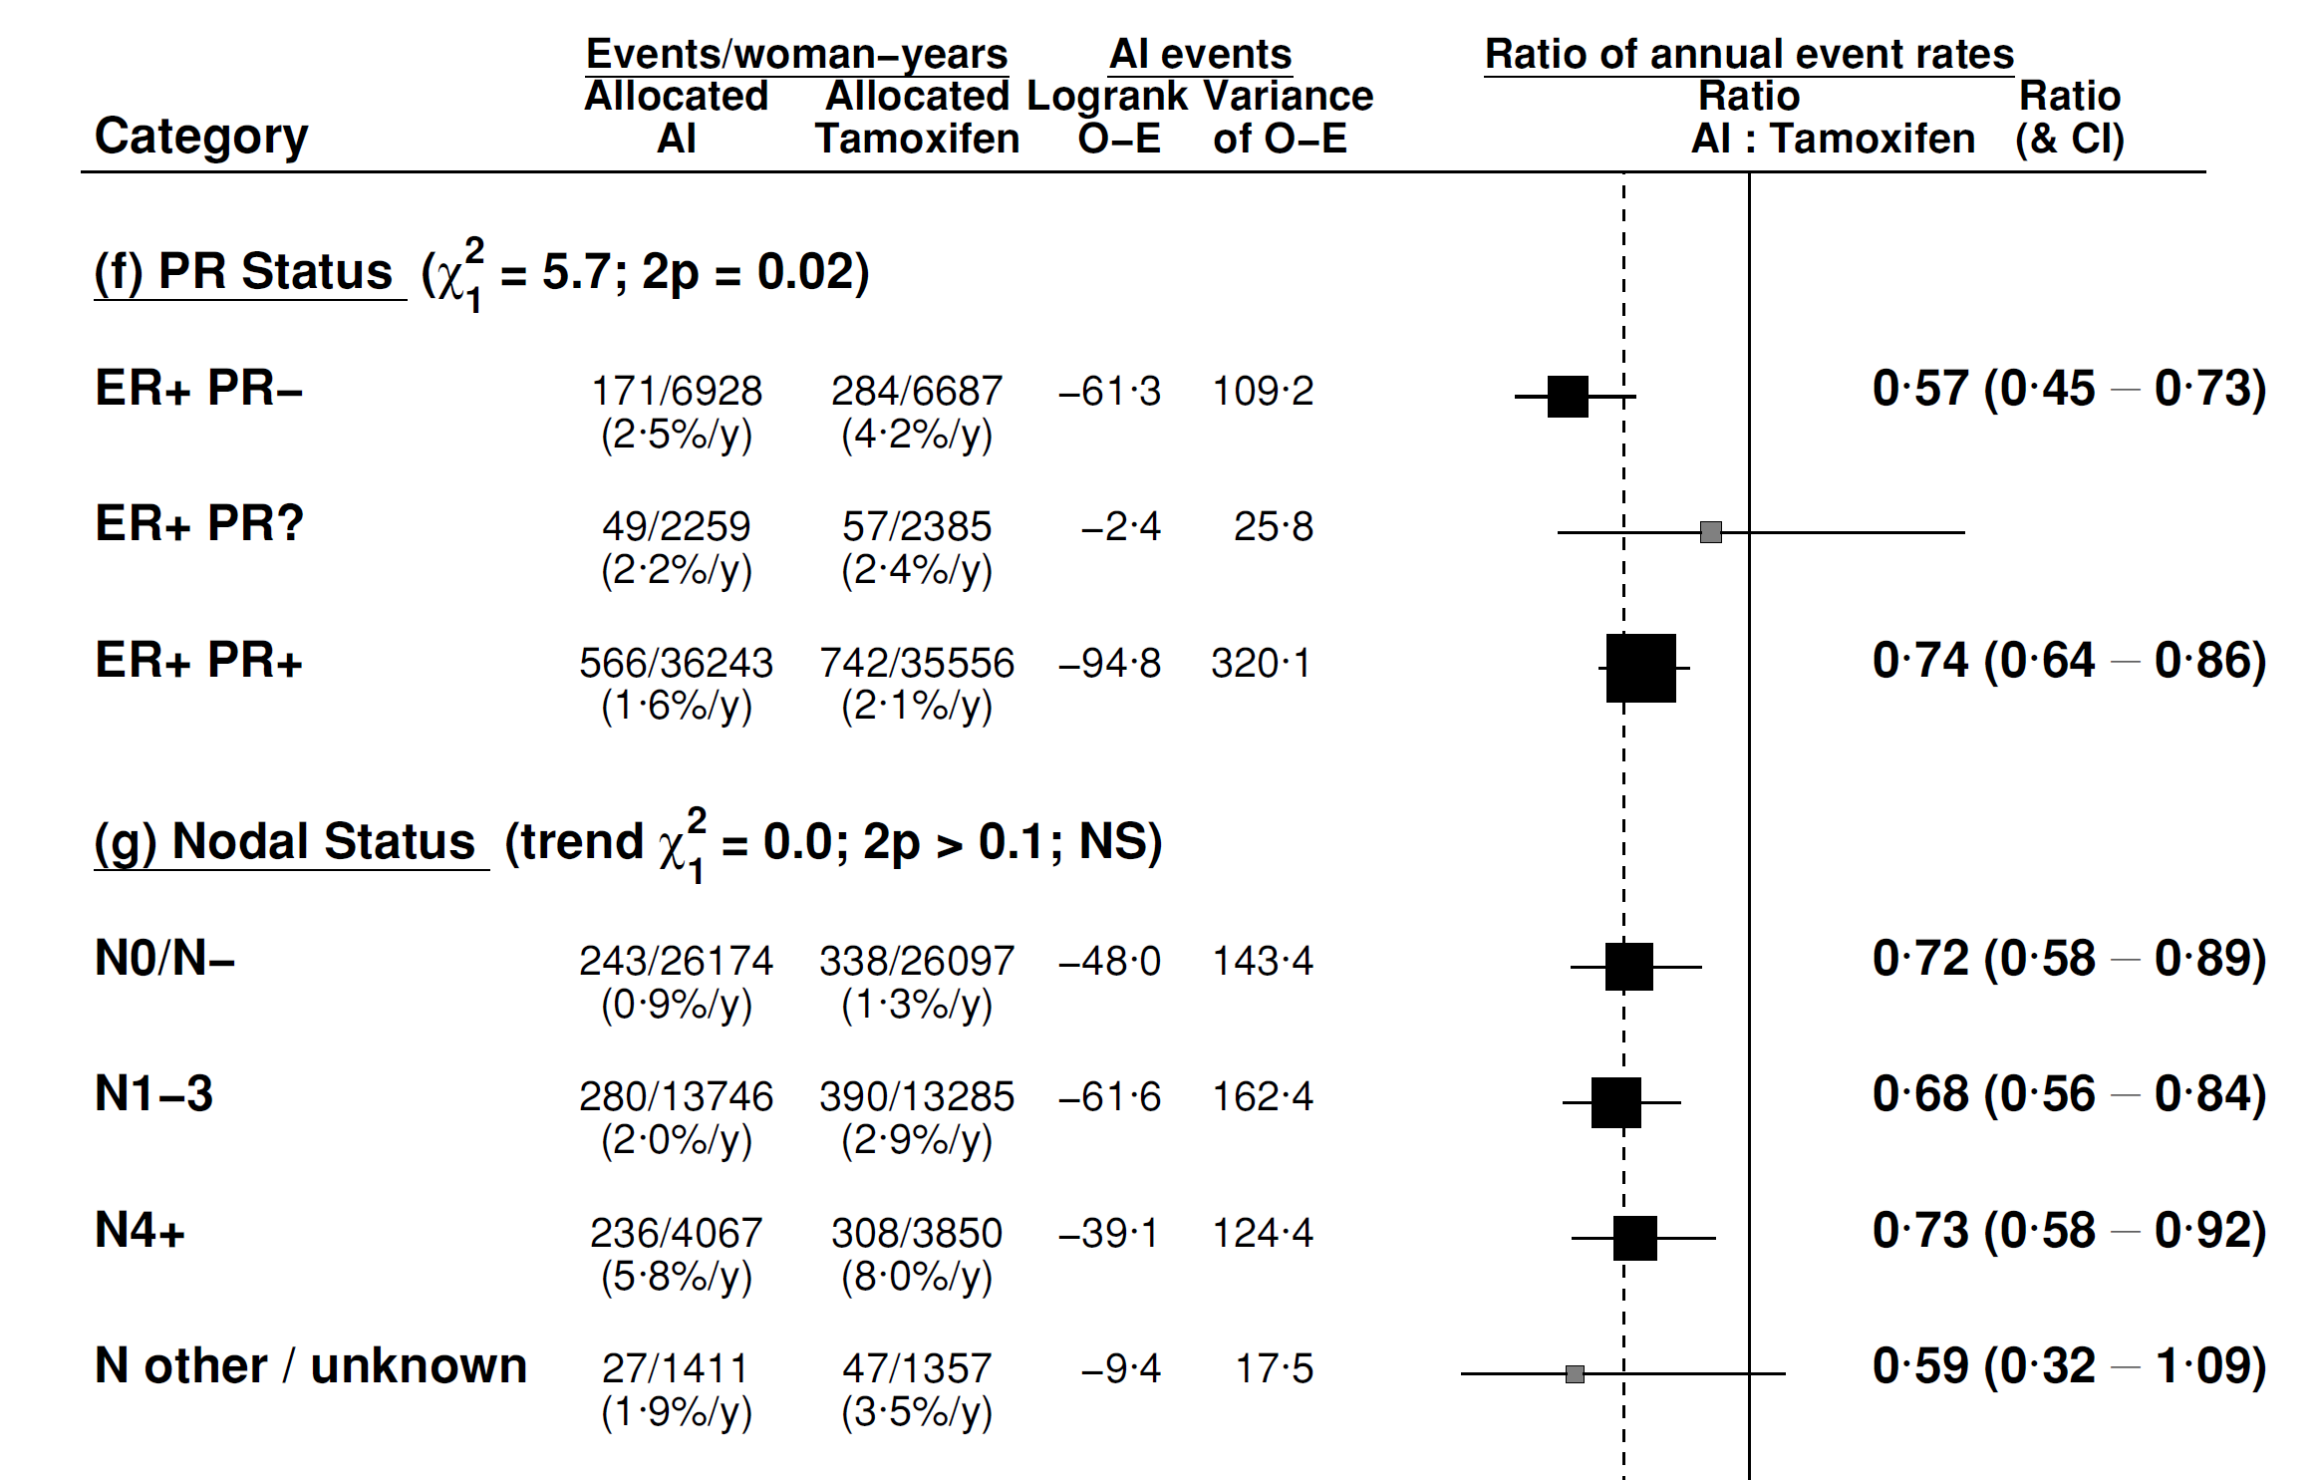
AIs: recurrence by PR and nodal status

Slide 16
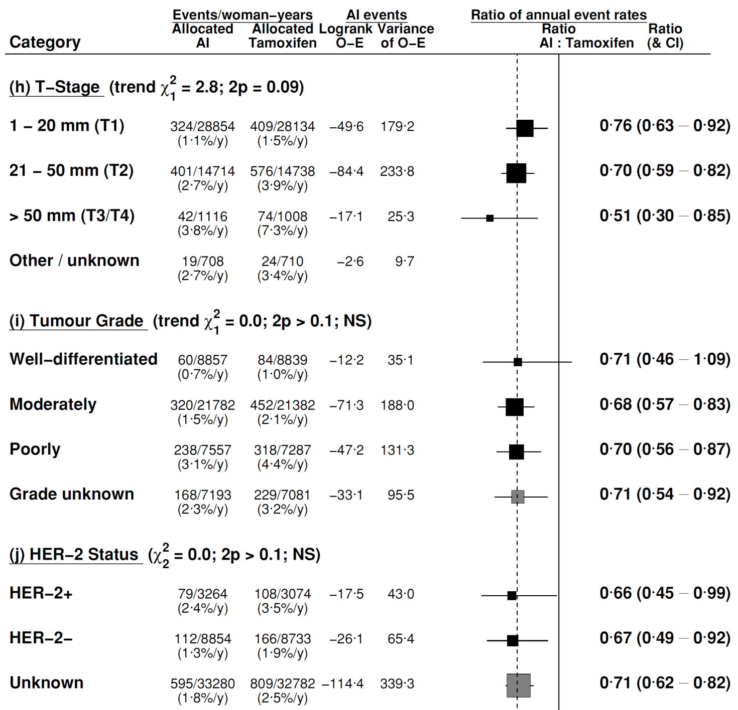
Recurrence by T-stage, grade and HER

Slide 17
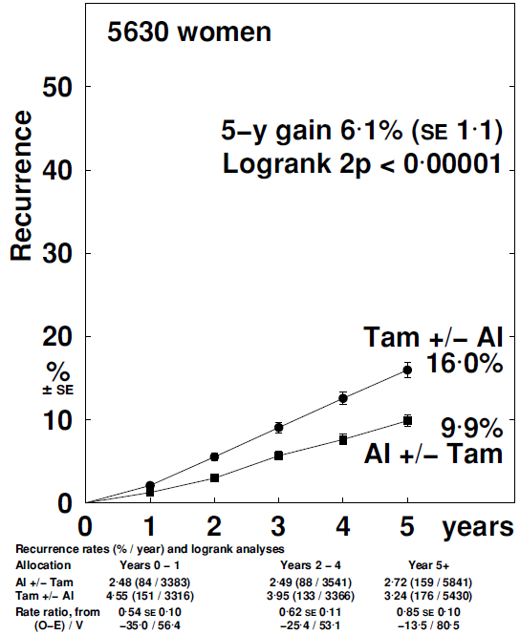
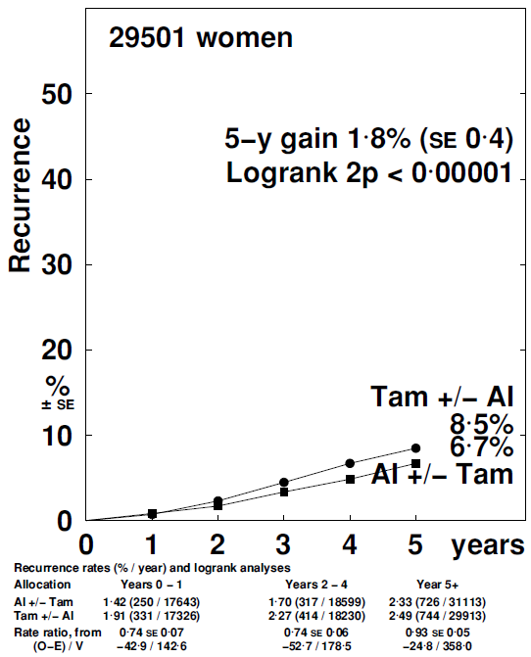
AIs: recurrence by PR status
PR-negative
PR-positive

Slide 18
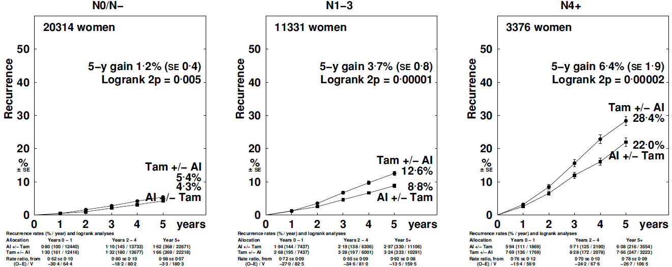
AIs: recurrence by N-stage
N-
N1-3
N4+

Slide 19
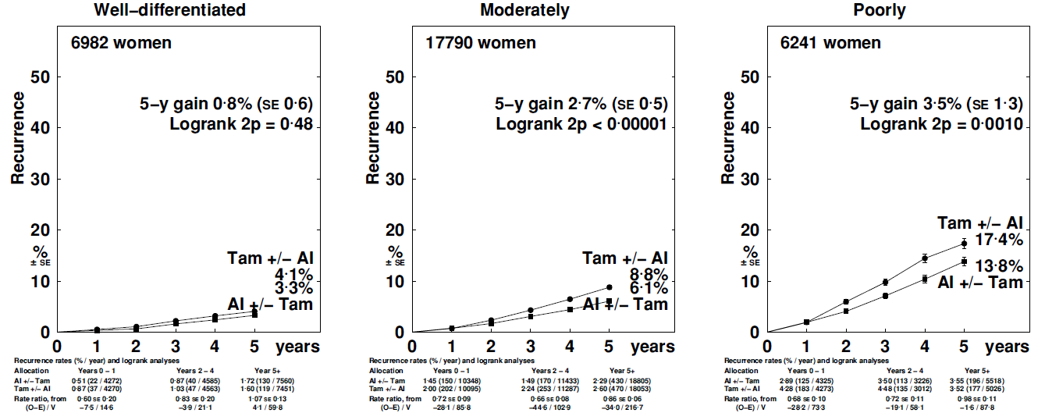
AIs: recurrence by grade
Well differentiated
Moderately differentiated
Poorly differentiated

Slide 20
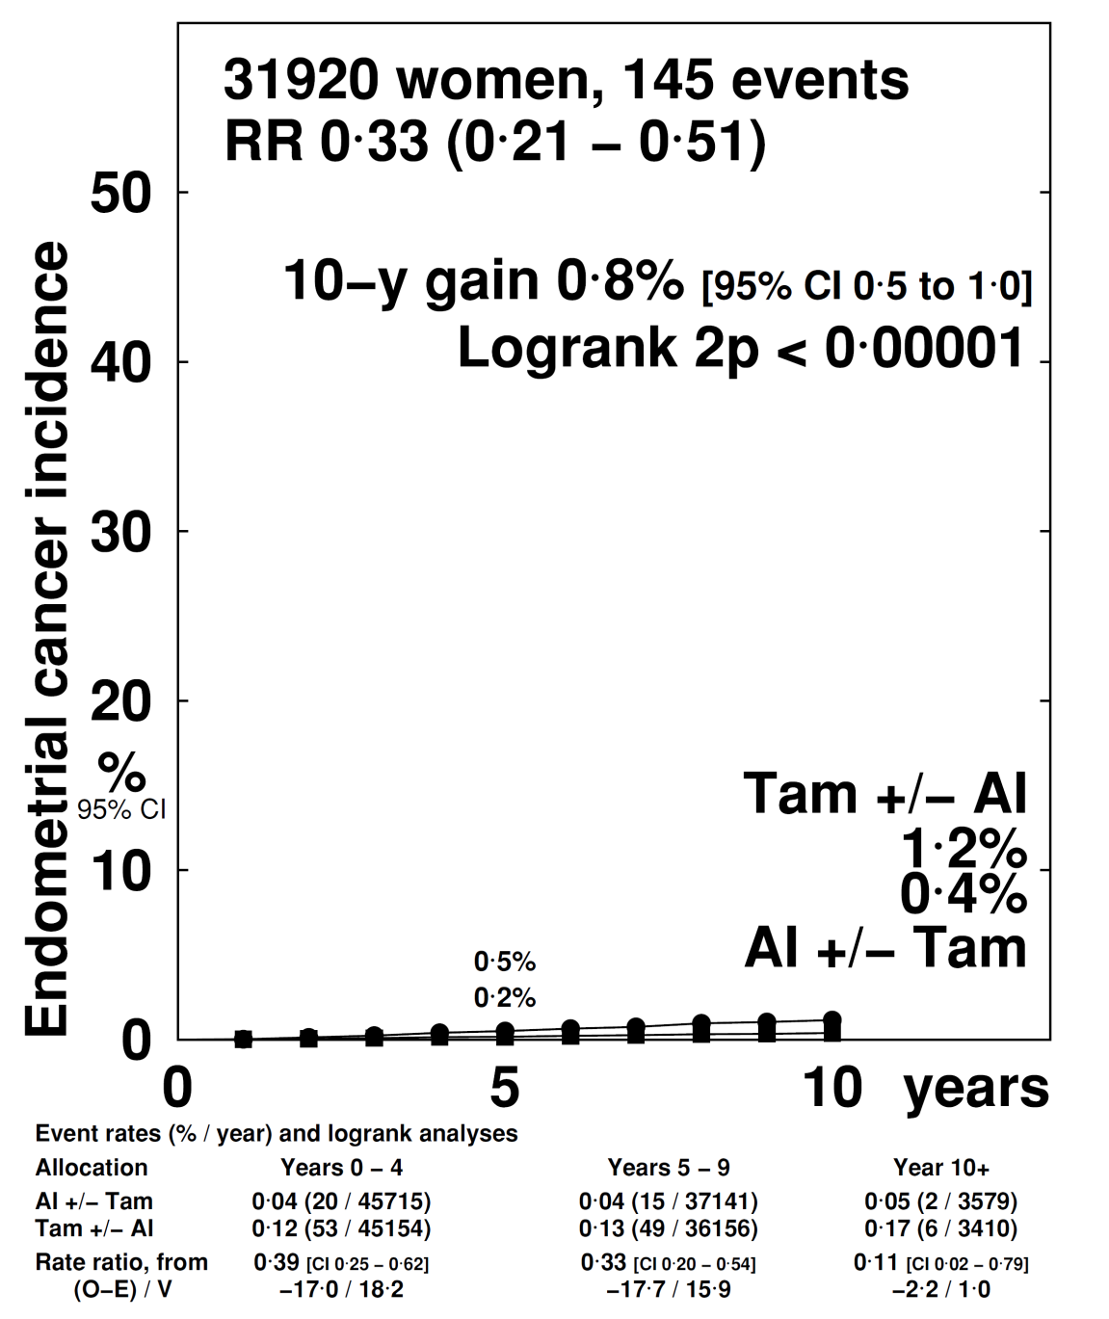
AI vs Tam endometrial Ca (all trials)

Slide 21
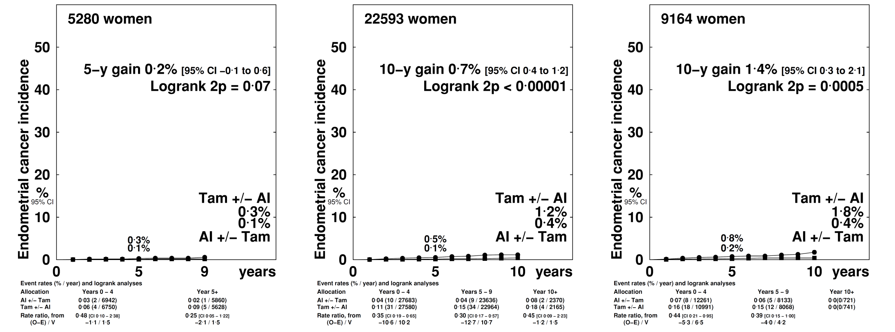
AI vs Tam endometrial Ca (all trials)
Age <55
Age 55-69
Age 70+

Slide 22
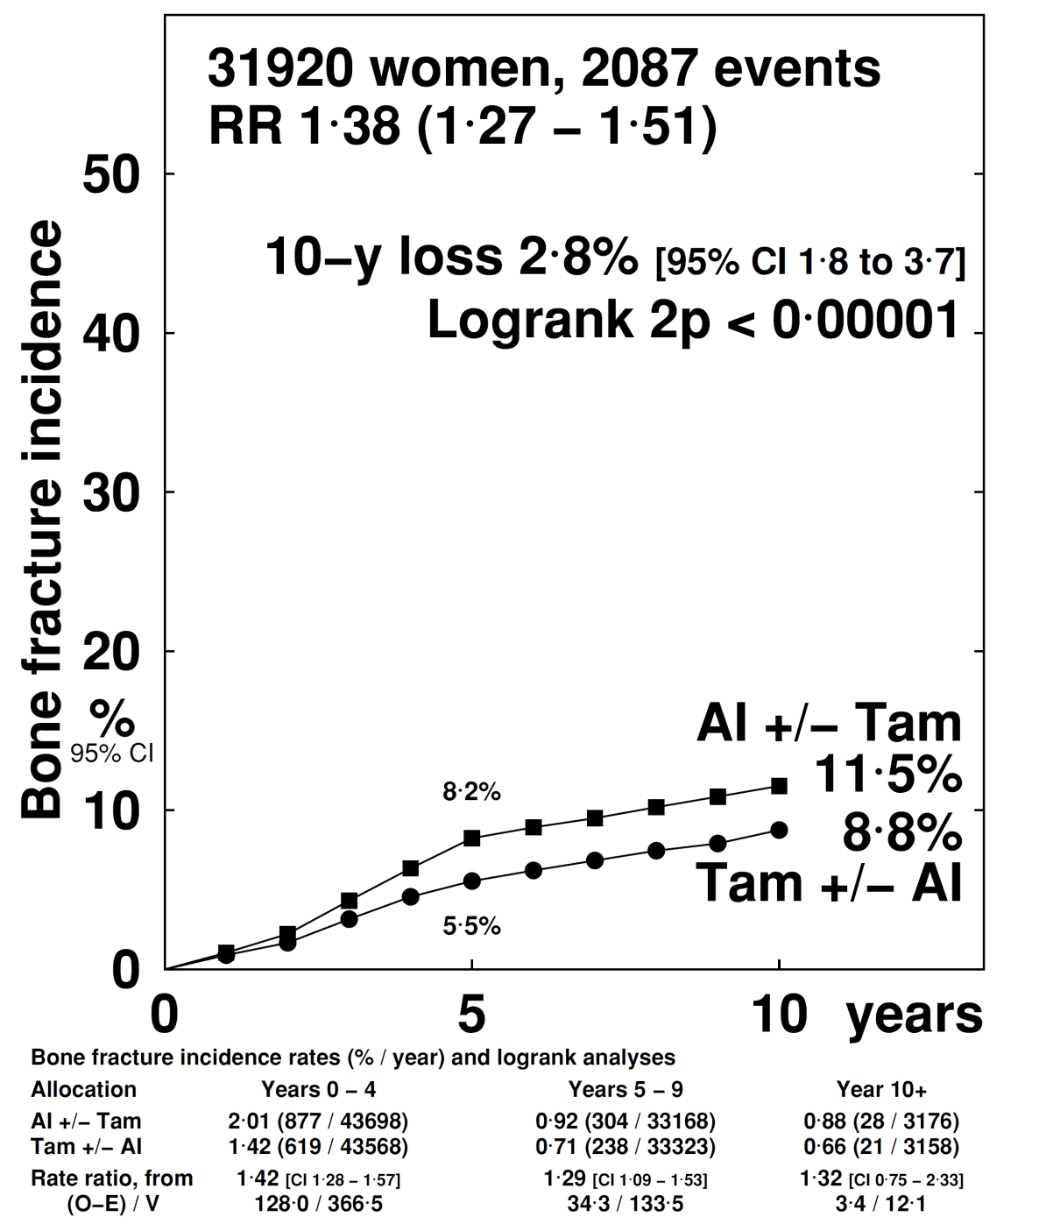
AI vs Tam bone fracture (all trials)

Slide 23
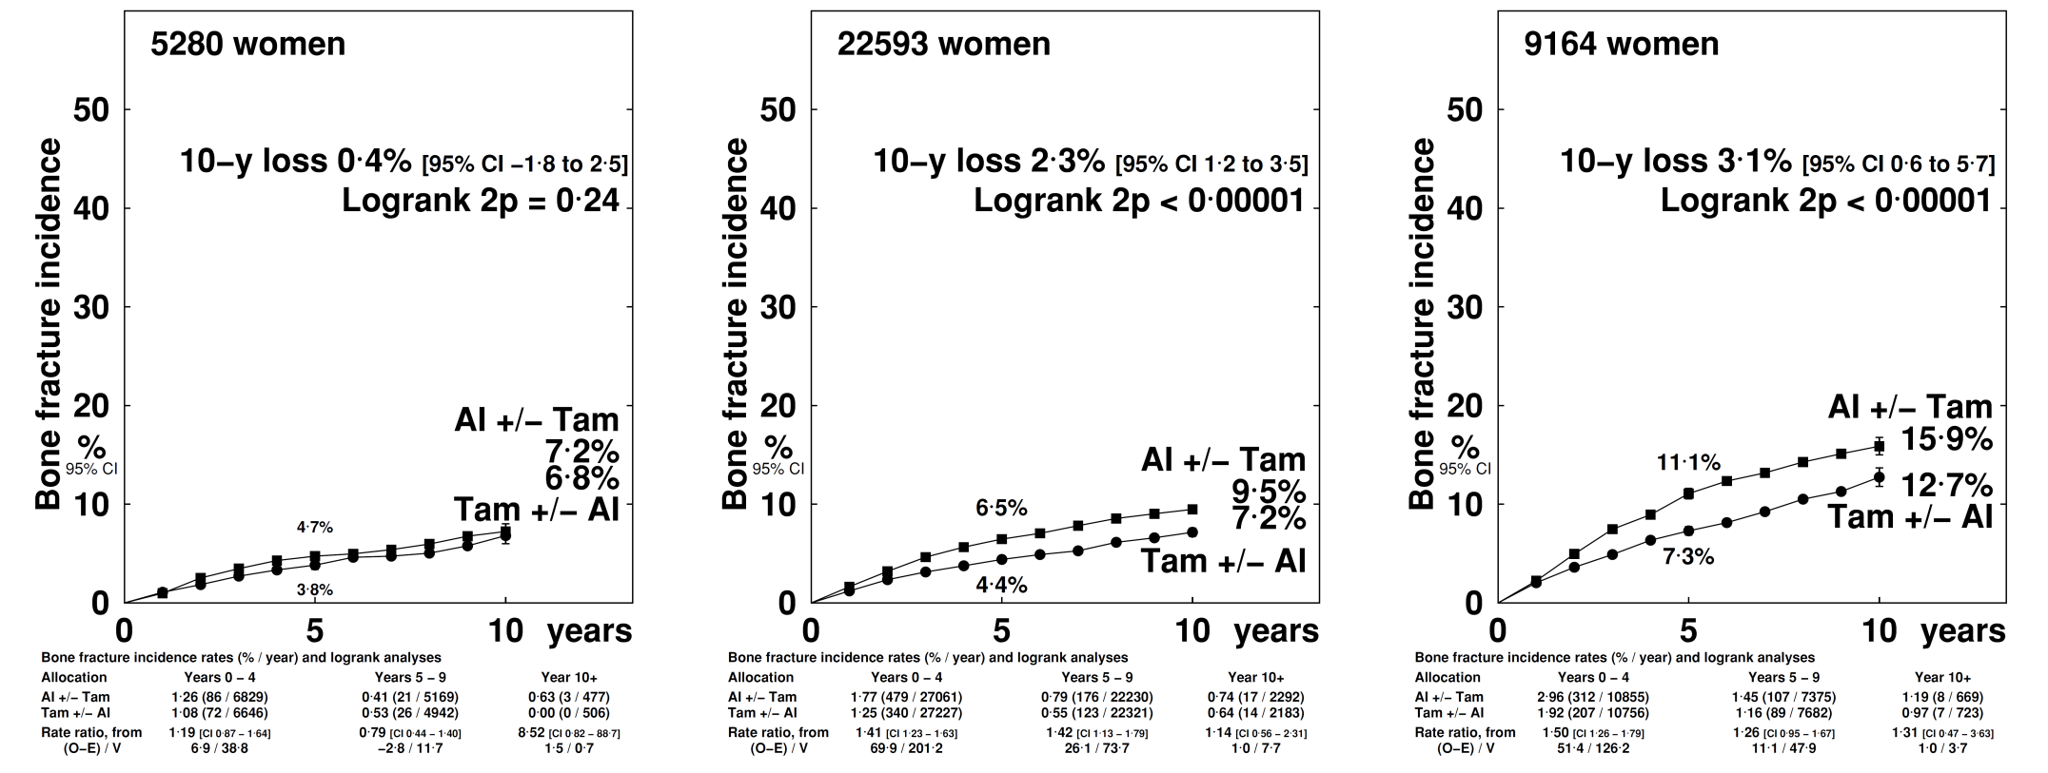
AI vs Tam bone fracture(all trials)
Age <55
Age 55-69
Age 70+

Slide 24
5 years AI vs no endocrine treatment
Breast cancer recurrence RR during: | 5 years tam. vs none: EBCTCG meta-analysis¹ (n=10 645) | 2) 5 years AI vs 5 yrs tam.: Present meta-analysis (n=34 882) | 3) 5 years AI vs none: estimated effects (product of two RRs)
- years 0-4 | 0.53 [95%CI 0.48-0.57] 2p<0.0001 | 0.70 [0.64-0.77] 2p<0.0001 | 0.37 [0.33-0.42] 2p<0.0001
- years 5-9 | 0.68 [0.60-0.78] 2p<0.0001 | 0.92 [0.83-1.01] 2p=0.082 | 0.63 [0.53-0.74] 2p<0.0001
BCM
- years 0-4 | 0.71 [0.62-0.80] 2p<0.0001 | 0.78 [0.67-0.91] 2p=0.002 | 0.55 [0.45-0.67] 2p<0.0001
- years 5-9 | 0.66 [0.58-0.75] 2p=0.0001 | 0.91 [0.80-1.02] 2p=0.12 | 0.60 [0.50-0.72] 2p<0.0001

Slide 25
Aromatase inhibitors – conclusions
AIs are even more effective than tamoxifen in preventing recurrence and breast cancer death
5 years of an AI reduces 10-year breast cancer mortality by at least 40% compared to no endocrine treatment
There are 30% fewer recurrences while treatments differ but little difference thereafter
Hence , if AIs are to be used, better to start with an AI than with tamoxifen
More bone fractures with AI but no differences in non-breast cancer mortality

Slide 26


Acknowledgements
We thank the tens of thousands of women who took part in the trials, the many staff in trial centres and participating clinics who helped conduct the trials, and the trialists who shared their data.
This presentation was prepared by Rosie Bradley and Richard Gray of the EBCTCG Secretariat, which is funded through direct support from Cancer Research UK and the UK Medical Research Council, to the Clinical Trial Service Unit and Epidemiological Studies Unit, Nuffield Department of Population Health, University of Oxford, UK.

